Slide 1
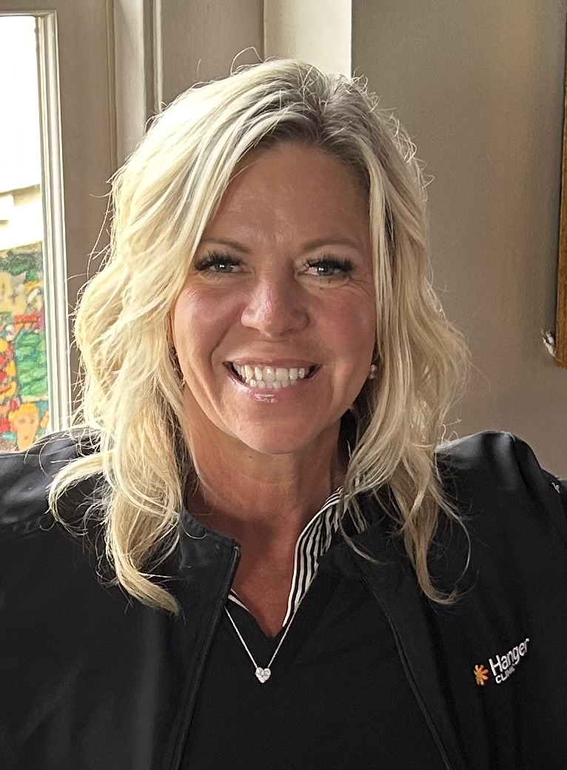

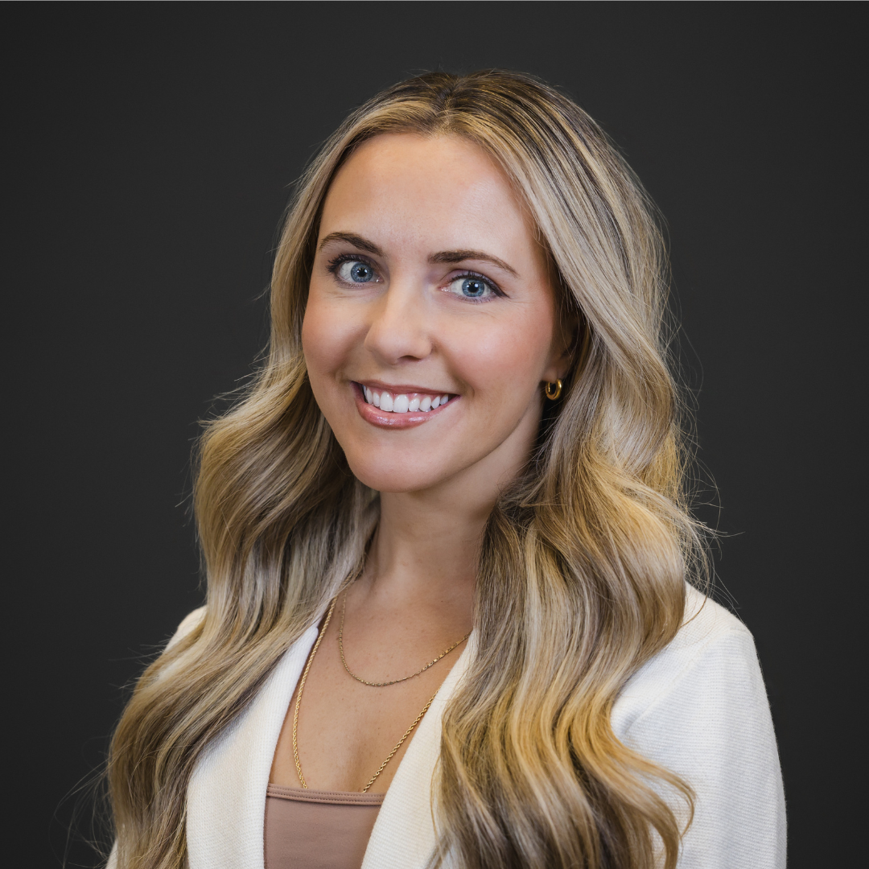
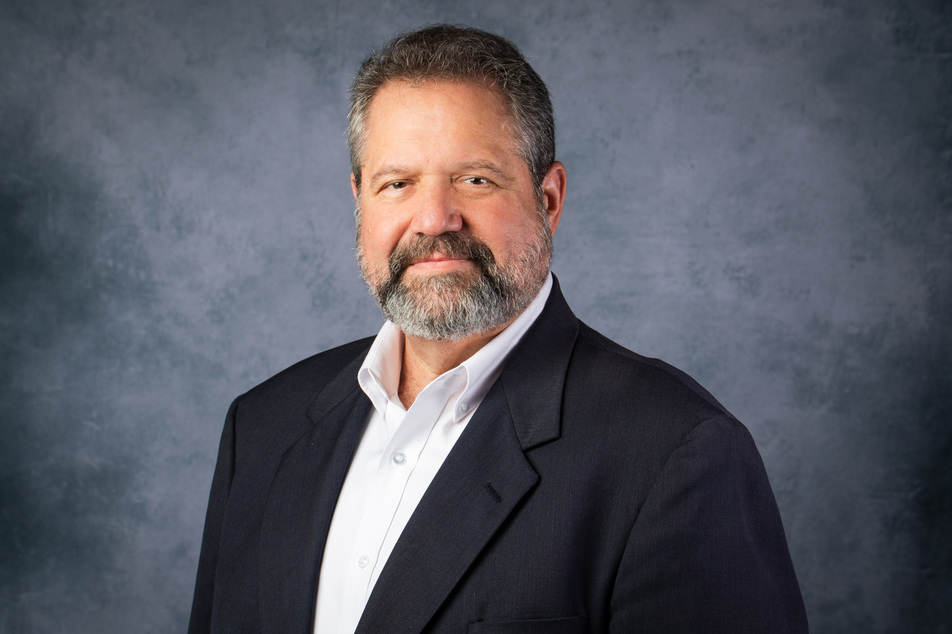
Speakers
Carrie Davis, MA Organizational Leadership
Wendy J. Remington,
CPO
Kaitlin Rivest,
CPO, MSPO
Jim Lawson
(moderator)
Vice President of Patient and Employee Experience
Hanger Inc., and Hanger Clinic
Assistant Residency Director, OrthoPediatrics Specialty Bracing
Boston Orthotics & Prosthetics
Manager of Outreach Development
ABC
Clinical Leader of Lower Extremity Care Excellence Hanger Clinic

Slide 2


Slide 3
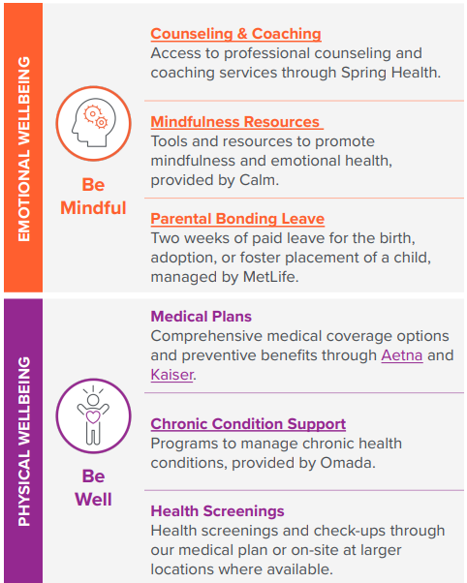
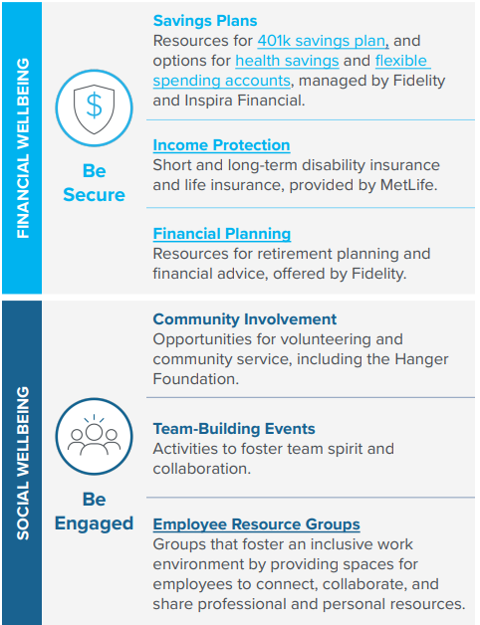

Slide 4


Slide 5

Leadership Drives Culture
When wellness is modeled at the leadership level, it naturally integrates into clinical practice.
Notes:
Team wellness starts at the top—and shows up in every clinic interaction.
Organizational priorities shape daily clinic experiences
Local leadership behaviors influence team morale and patient care
Small, consistent actions create a culture of wellness

Slide 6



Clarity Reduces Stress
Structure in communication
Reduces Stress
Improves Clarity
Strengthens Team Cohesion
Notes:
Strong communication = Strong teams
Conversations
Encourage open, respectful dialogue
Create space for feedback and active listening
Clear Expectations
Define roles, responsibilities, and goals
Align team around shared clinical and operational priorities
Support Systems
Provide access to leadership and mentorship
Foster psychological safety and trust
reduces stress improves clarity strengthens team cohesion

Slide 7

Team First Environment
Nurturing team centered workplace + Encouraging collaboration = Improved results
Notes:
Culture is what your team experiences every day
Nurturing a Team-Centered Workplace
Recognize contributions and celebrate wins
Promote balance and well-being
Increasing Collaboration
Encourage interdisciplinary teamwork
Break down silos between clinical and administrative staff
Result:
Higher engagement
Better patient outcomes
Stronger retention and satisfaction

Slide 8

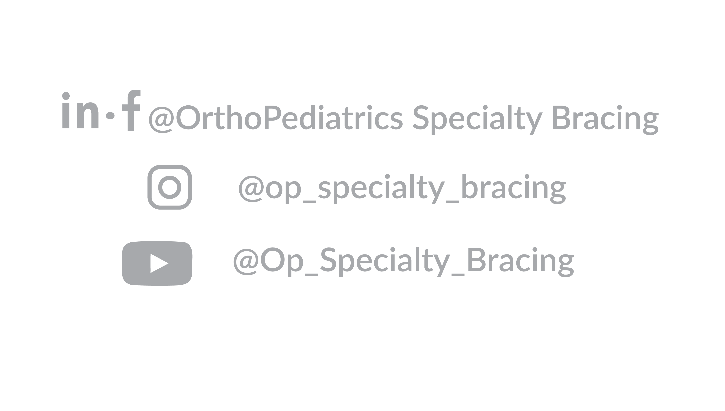

Prioritizing Wellness to Build High-Performing POP Teams
Kaitlin Rivest, CPO | Boston Children’s Hospital
OrthoPediatrics Specialty Bracing, Formally Boston O&P
37 Shuman Avenue
Stoughton, MA 02072 USA

Slide 9
Healthy Teams, Happy Patients
Wellness is not just a perk or a benefit
Our clinician’s wellbeing DIRECTLY AFFECTS PATIENT CARE
Today I’ll share:
  How OPSB promotes wellness nationally as an organization
  How we support wellness in residency training and in my own clinic
  How this ultimately improves care for our pediatric patients

Slide 10
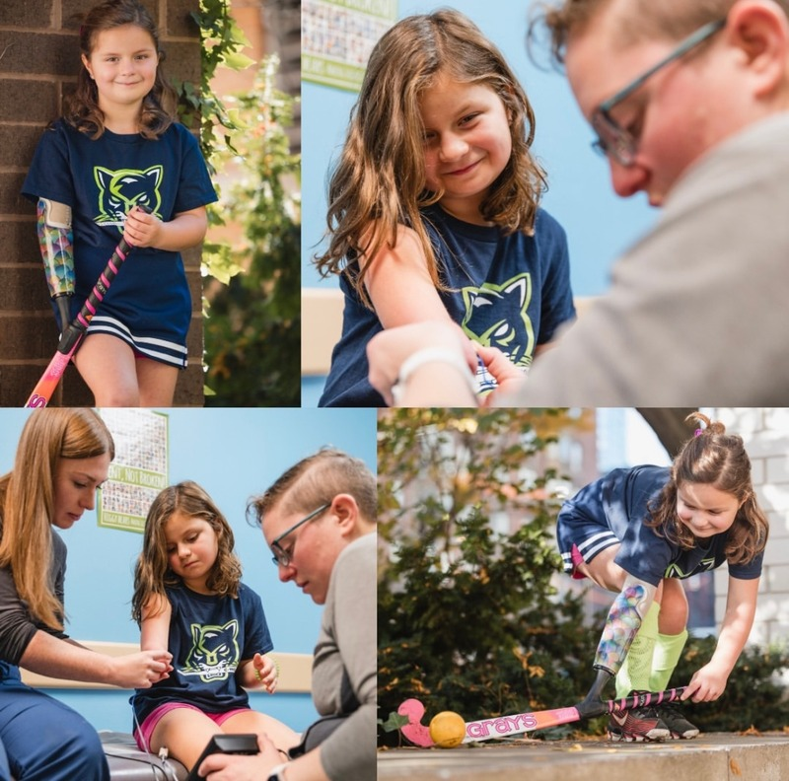
Why Wellness Matters in POP
Wellness Drives Clinical Excellence
  Burnout impacts patient care
  Pediatric care can be especially emotionally demanding
  Strong teams provide better outcomes
  Investing in clinicians = investing in patients
Notes:
So many clinicians manage complex clinical, emotional, and physical workloads.
In pediatrics, families depend on us during difficult moments.
If clinicians are supported and engaged, patients benefit directly.

Slide 11
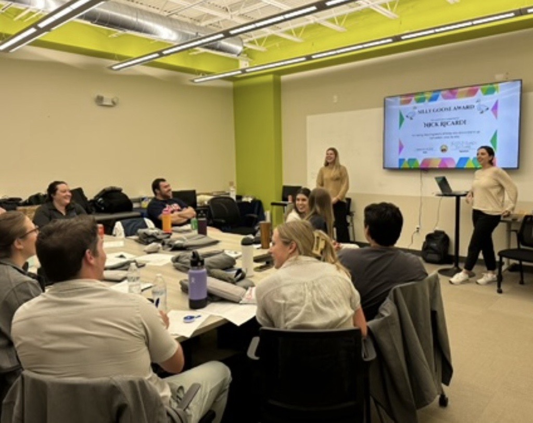

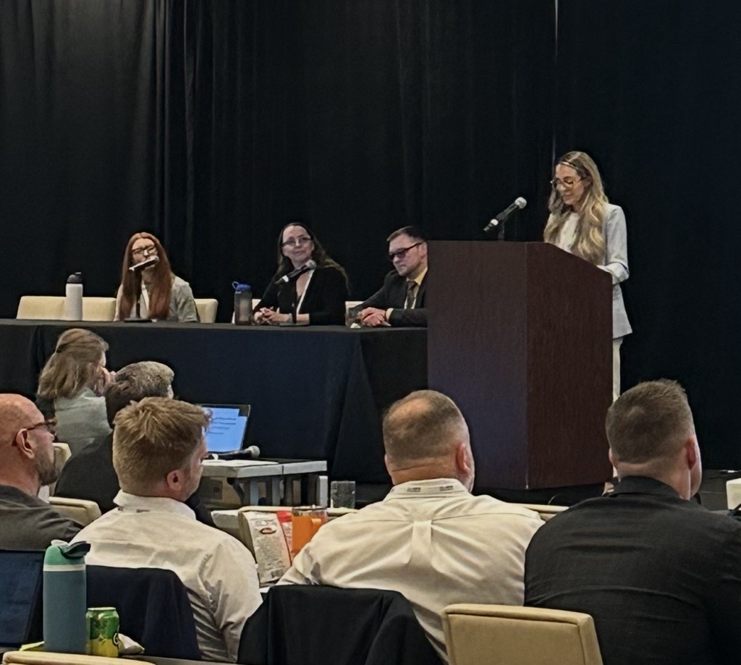
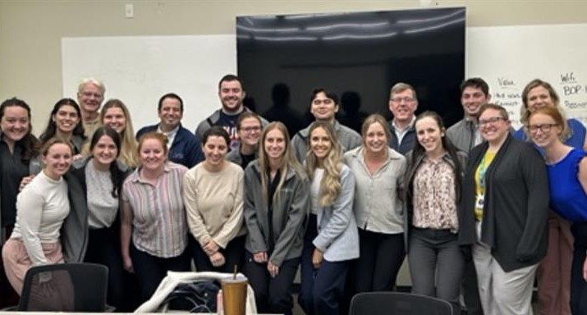
Our Organizational Commitment to Wellness
Our organization’s approach
  Flexible work structures
  Empowered leadership
  Opportunities for professional engagement
  Maintaining a connected culture
Notes:
Flexible work structures
Many clinicians work 4-day weeks (10-hour days)
Others prefer traditional 8-hour schedules
Clinics can build rotating schedules or long weekends
Empowered leadership
Ideas come from the clinicians, techs and patient care coordinators who are doing the work daily for our patients, not just upper management
Staff help shape processes and improvements
Professional engagement
Encouraged to participate in:
ABC
NCOPE
Academy
Presenting at conferences
Connected culture
Even as we grow nationally, we maintain a small-organization feel

Slide 12
Creating Connection Across the Organization
Building Community
  Internal communication (social teams)
  Sharing life updates and clinic stories
  Opportunities to join improvement teams
  All employees are stakeholders in our parent company
Notes:
We use internal channels where employees share personal milestones, clinic wins, and stories.
These small things help build trust and connection across locations.
Employees can also join focus teams in areas that they are interested in. This is not a requirement for employees, but many employees do joint these teams because they are how we set standards throughout our organization and clinicians want their voices heard! We have spinal, cranial, prosthetics and lower limb teams in our organization. Clinicians often join subgroups that set standards, do research, come up with outreach activities and overall progress clinical improvement.
Employees receive protected time during the workday to contribute to these voluntary groups!
Every employee is also a shareholder in Orthopediatrics, reinforcing shared success.
All in all - Our mission of advancing pediatric O&P care cannot happen without putting our employees first.

Slide 13
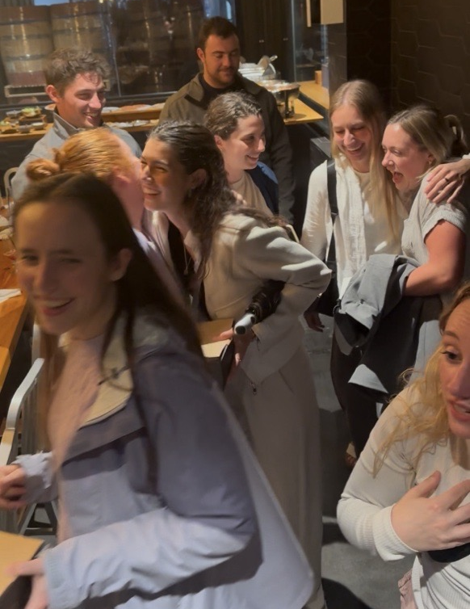
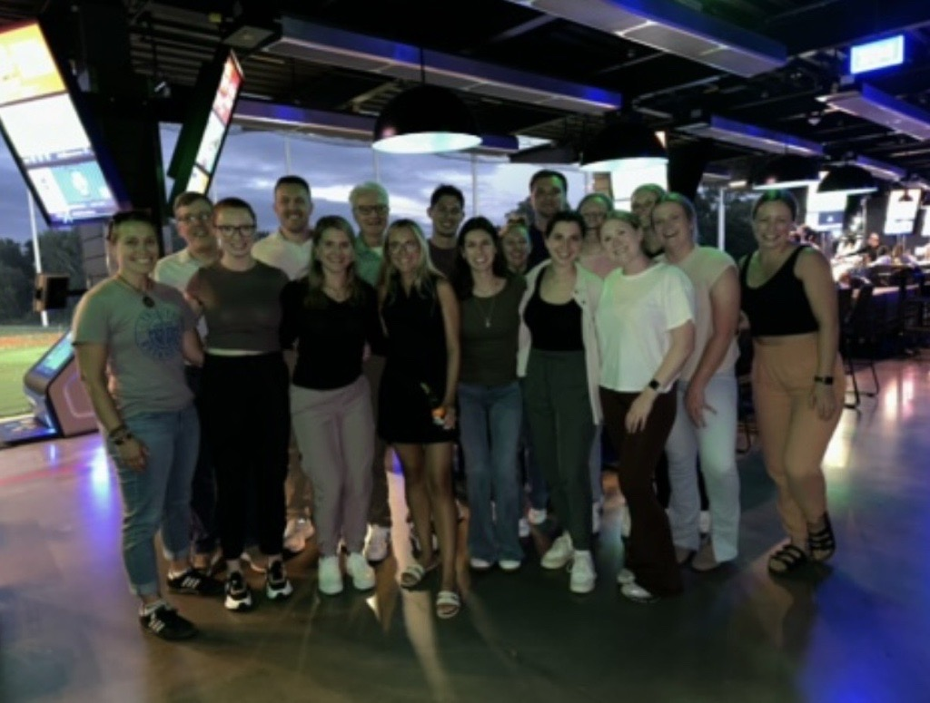
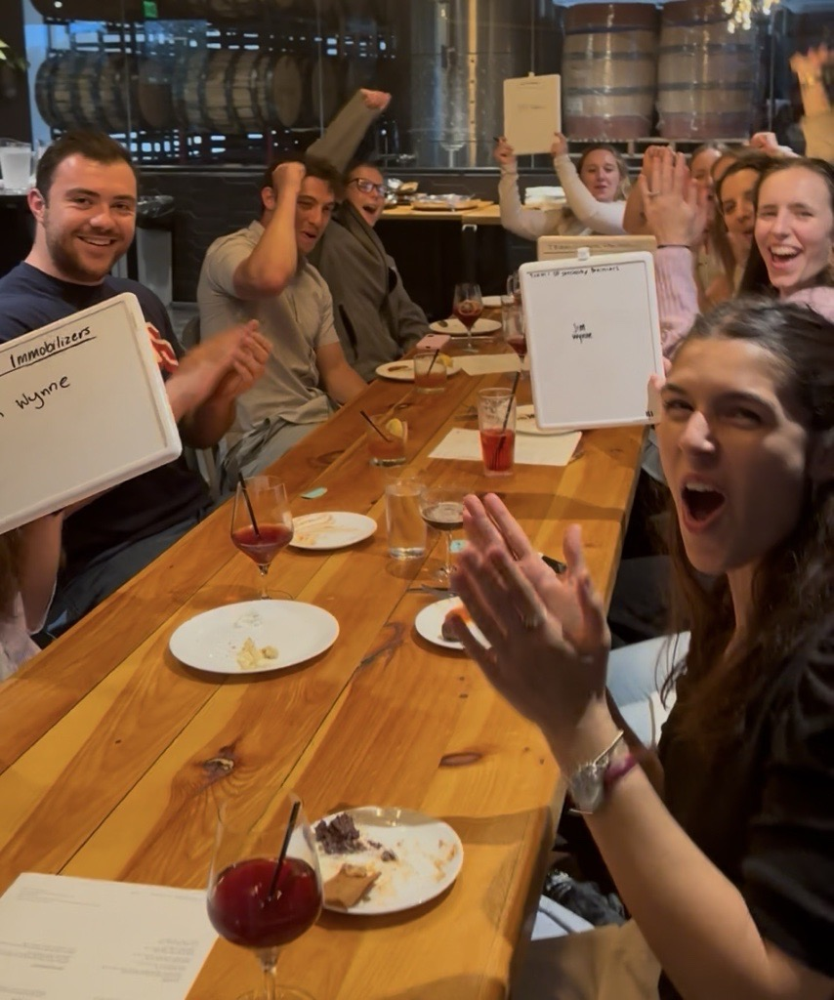
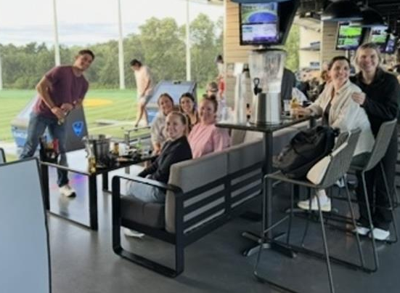
Supporting Wellness in Residency and New Employee Training
Starting residents and new clinicians on the right path
  Mentorship and support systems and encouraging involvement
  Building confidence and resilience
  Team bonding
Notes:
At our company we have a relatively large residency program and we know that Residency is a major transition period.
New clinicians are learning clinical decision-making while adjusting to full clinical responsibility and simply becoming an employee
Our goal is to:
Provide hands-on mentorship
Normalize asking questions
And Encourage professional participation early on
Starting careers in an environment that values wellness helps clinicians build healthy habits that last decades.
For example, we make sure we have all new employees and of course all residents come to our headquarters just outside of Boston regardless of the region they will be working in. We have them come in groups, 3 times each year for live in person trainings, team bonding, fun activities and so they personally get to know the people they will be interacting with and hearing from on a daily basis – so everyone from our technicians, to customer service and to upper management – because getting to know each other on a personal level can help foster a family environment and overall wellness. We also do a residency event yearly where all of the residents come up for a couple of days to meet and do some team bonding activities like top golf and trivia.

Slide 14
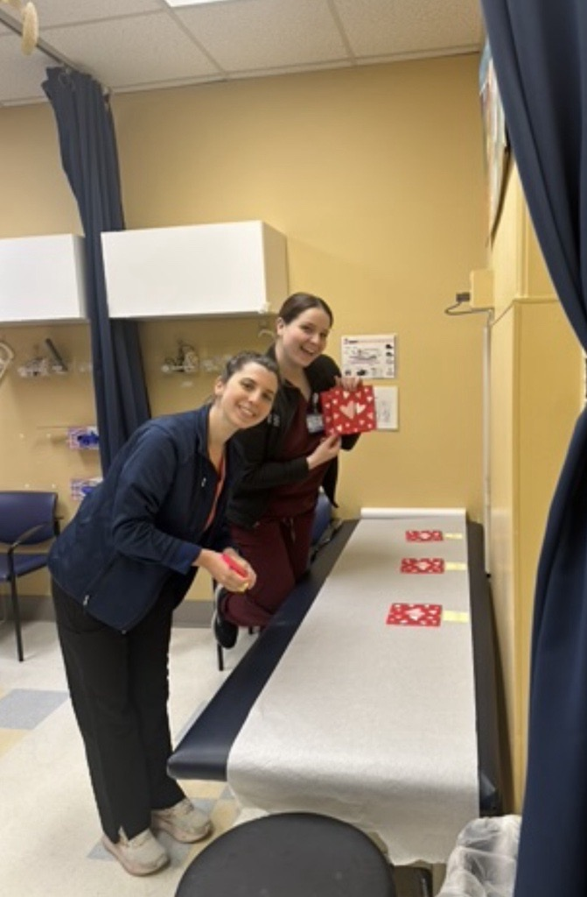
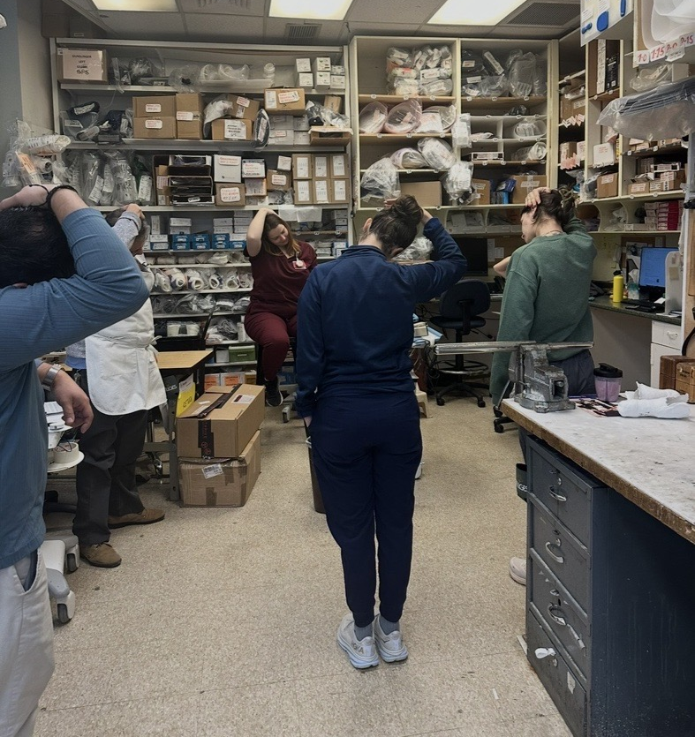
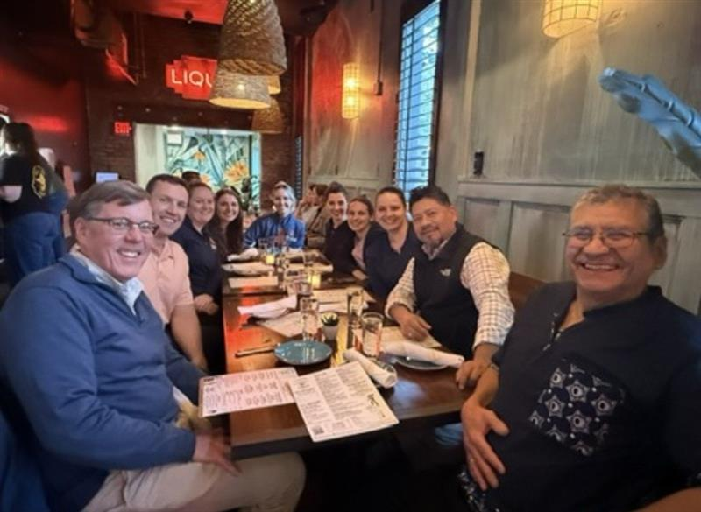
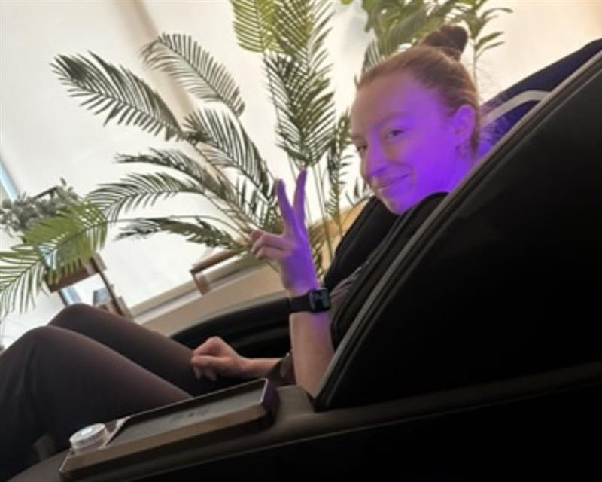
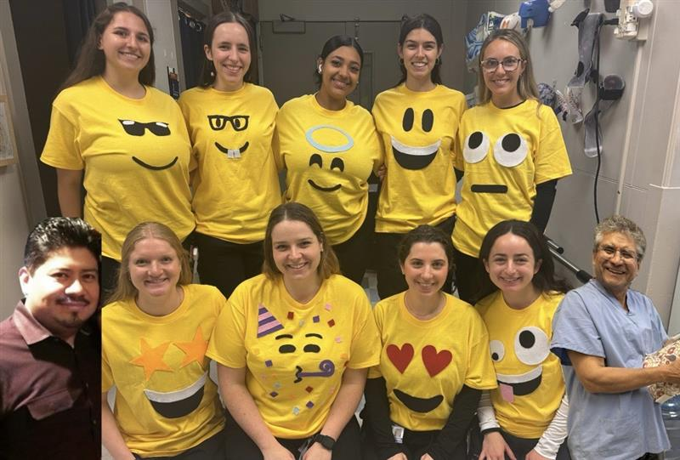
Wellness in our Boston Children’s Hospital Clinic
Daily Practices that Support the Team
  Morning team huddle and stretch
  Shared workload and schedule awareness
  Collaborative patient care
Notes:
Every Morning we have a group huddle where we Review schedule, Identify if someone is overloaded, Reassign support when needed and a couple of years ago my colleague even started her own stretching ritual which we have dubbed “Julia’s stretching corner”. Seems somewhat silly but taking a moment to reset and breathe really helps.
And as many of you who work in fast pace hospital settings know that Collaborative care is so Ortho pediatrics important!
Hospital schedules change constantly – what our schedule looks like at the beginning of the day can look completely different by the end since we have inpatients, outpatients, walk-ins and OR cases
Our Clinicians often co-treat patients to help each other and reduce stress.
Important point:
Helping each other ultimately helps the families navigating a complex hospital environment and receive care from many qualifies individuals instead of just one.

Slide 15
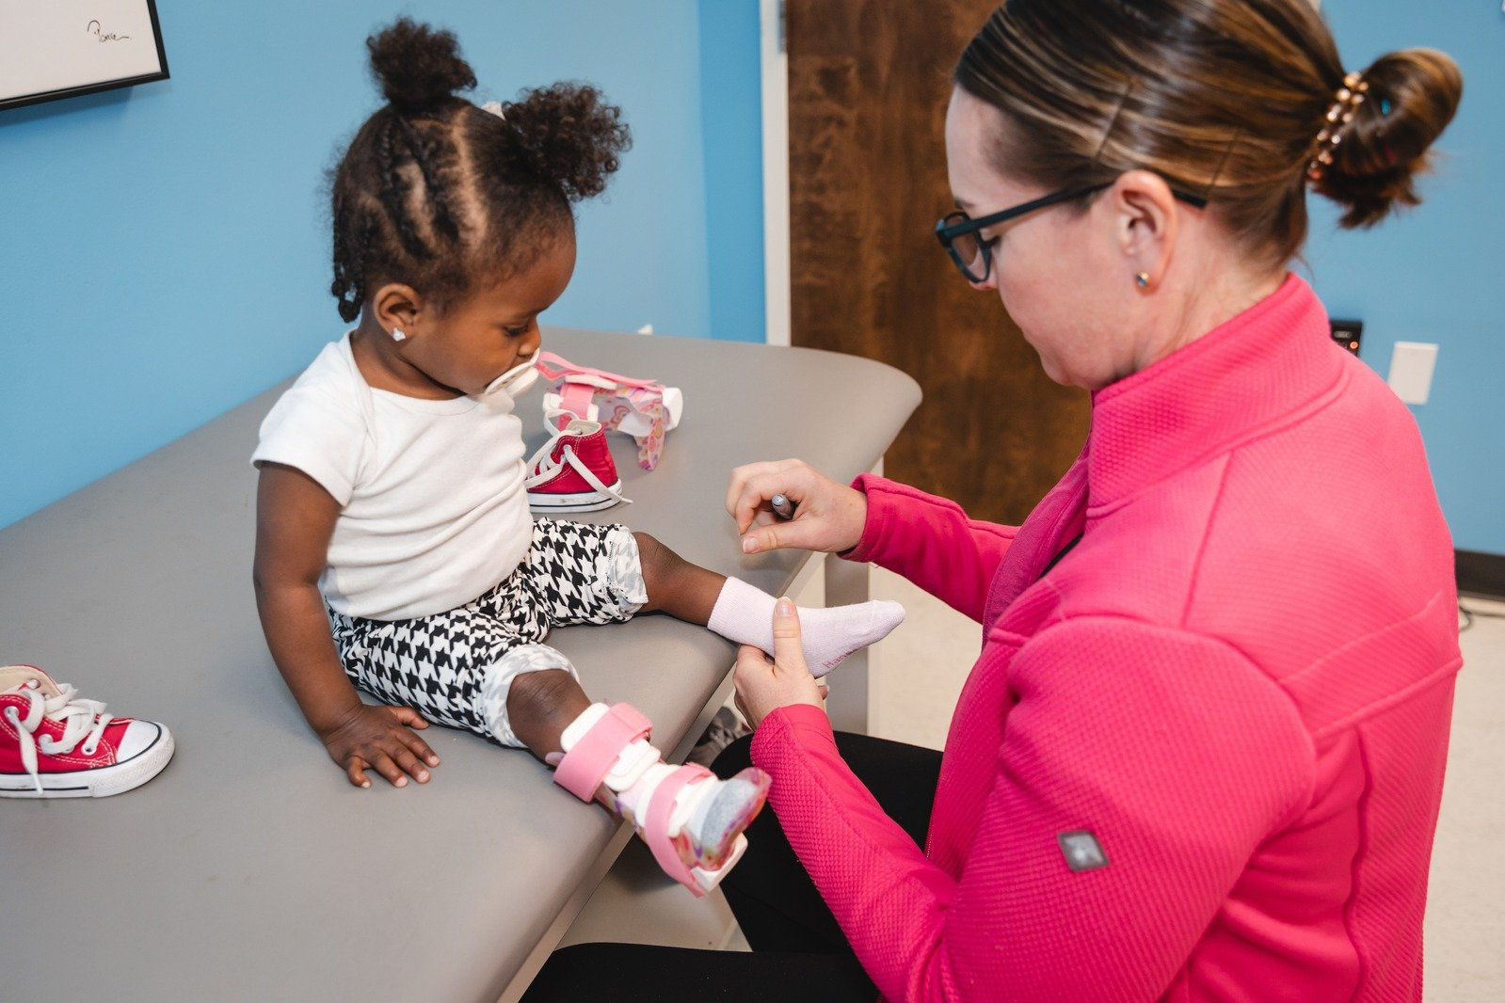
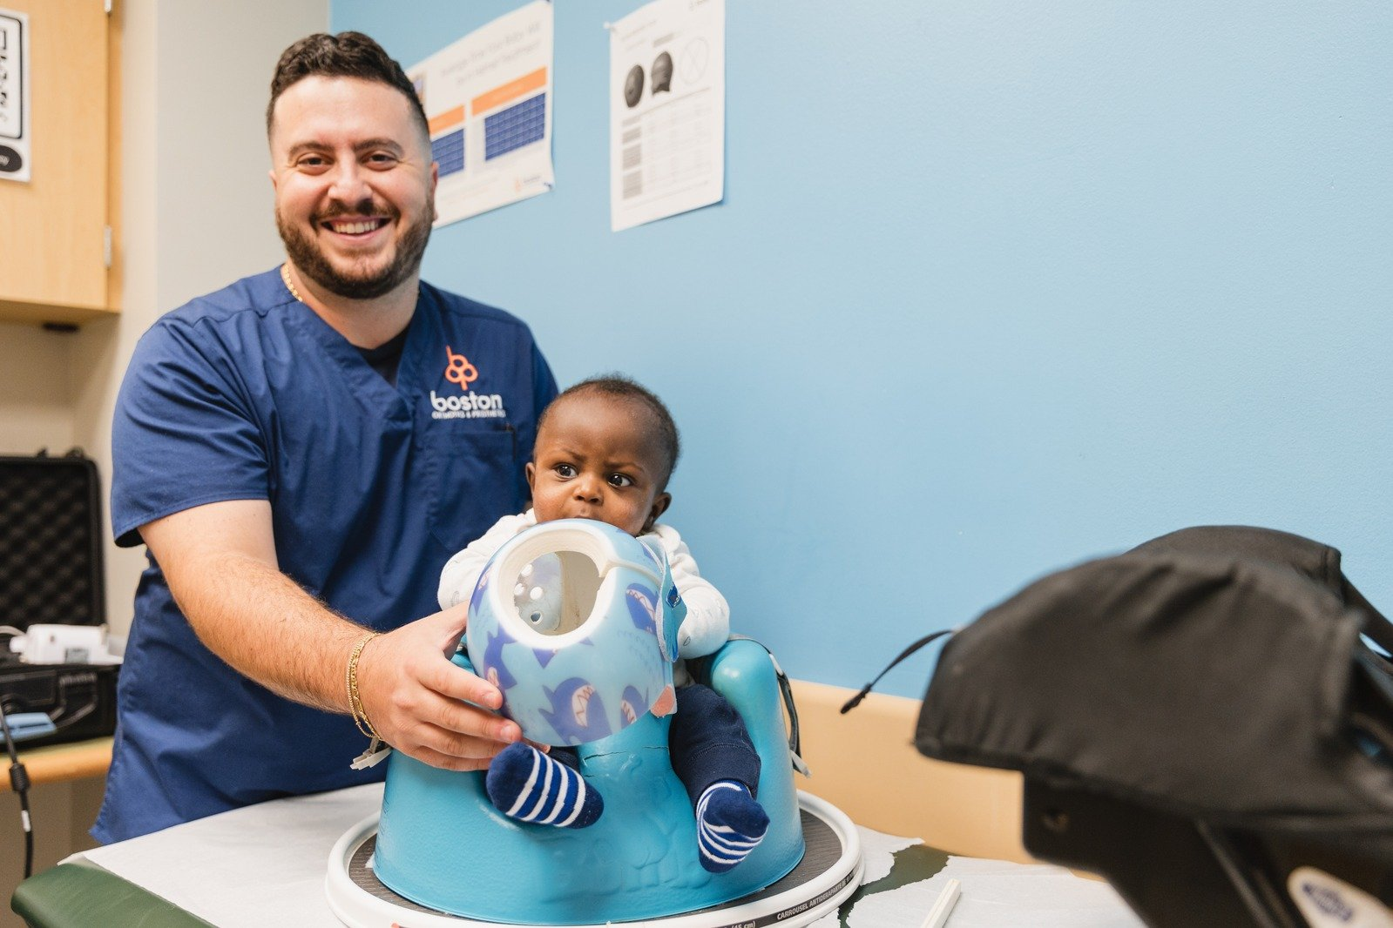
The Impact on our Pediatric Patients
Healthy Teams Deliver Better Care
  Supported clinicians provide better patient experiences
  Collaboration improves efficiency for families
  Strong teams sustain long-term careers within the organization
  Wellness strengthens our mission to serve children and their families
Notes:
So to Bring it full circle:
Pediatric patients and families often have really long, complex care journeys.
But it all starts with us as clinicians – when we feel supported, we can show up with energy, empathy, and focus.
So Prioritizing wellness is really more than just employee satisfaction.
It’s about ensuring that we can sustainably provide the best care possible Bring it full circle:
Pediatric patients and families often have long, complex care journeys.
When clinicians feel supported, they can show up with energy, empathy, and focus.
Prioritizing wellness isn't just about employee satisfaction.
It’s about ensuring we can sustainably provide the best care possible for the patients we serve.
When we invest in the wellbeing of our clinicians, we strengthen our entire system of care for the patients and families who rely on us.

Slide 16


Thank You for Joining

