Slide 1
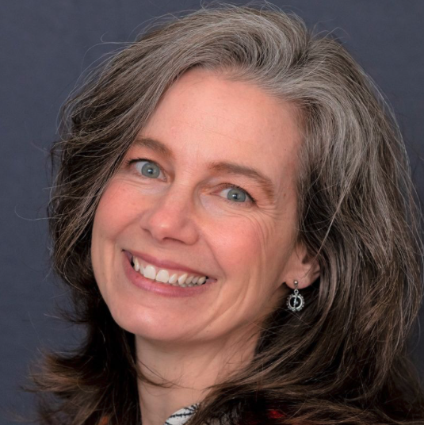
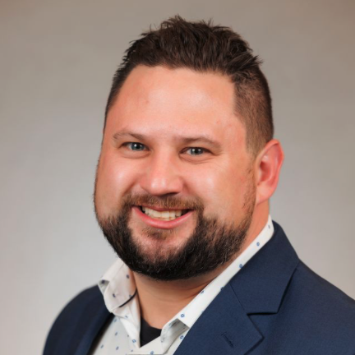
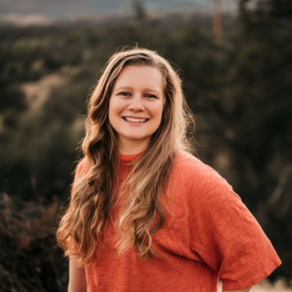
Speakers
Molly McCoy, L/CPO
Tony Gutierrez, MS, CP/LP
Katie Janiszewski, MSOP, CPO
Director, Clinical & Scientific Affairs
Hanger Clinic
Director of Clinical Advancement and Innovation
Bionic Prosthetics & Orthotics Group
Client Lead
Spectrum Orthotics & Prosthetics
Co-Founder
Align Medical Media

Slide 2

Integrating AI into
Prosthetic and Orthotic
Workflows
Tony Gutierrez, CP/LP
Director of Clinical Advancement and Innovation
Bionic Prosthetics and Orthotics

Slide 3
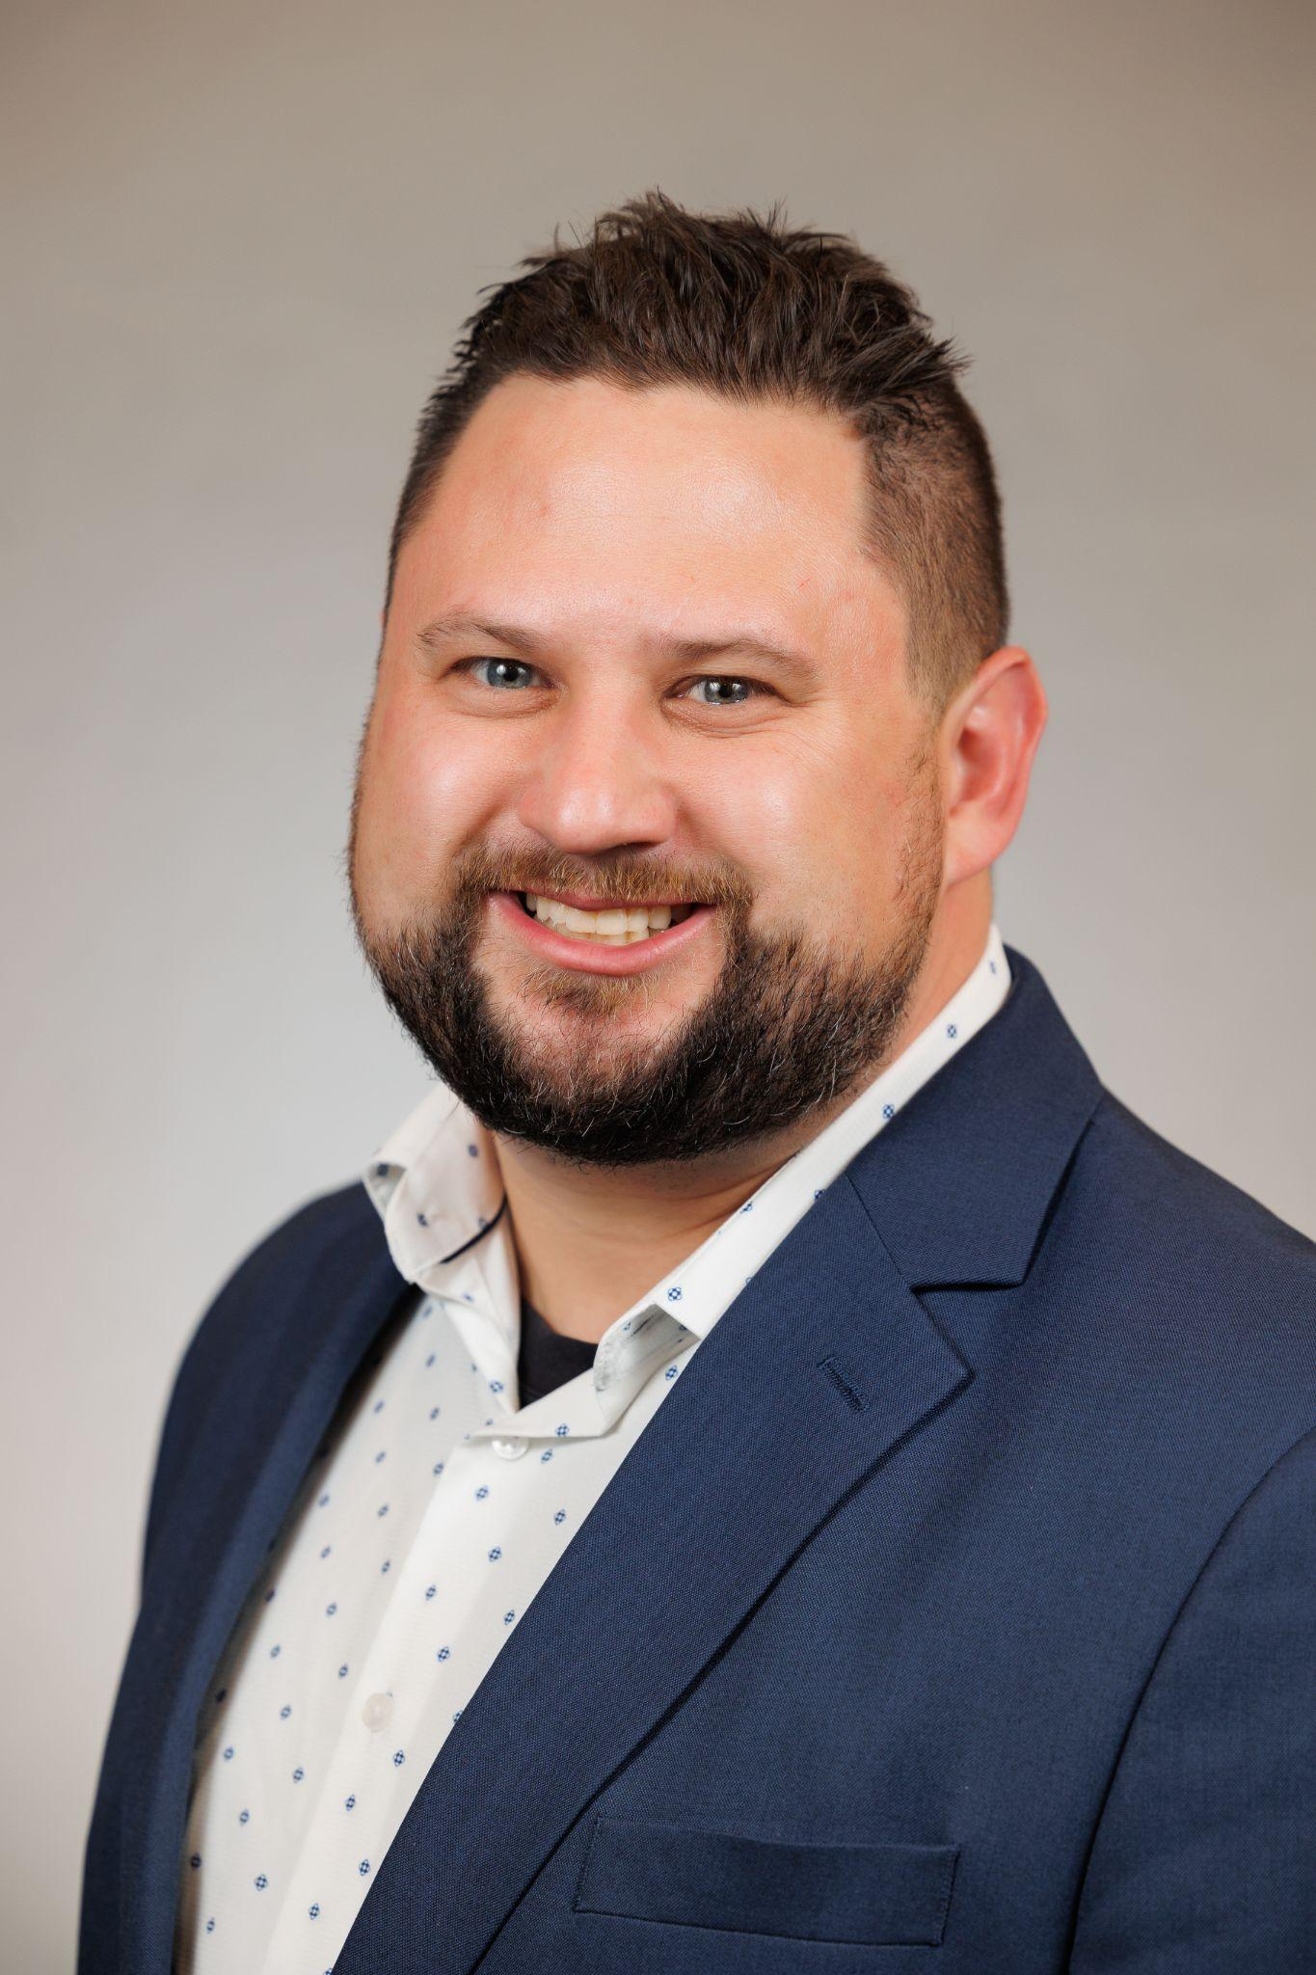

Tony Gutierrez CP/LP
2010 Graduate of the Northwestern University Prosthetics Program
16 years of clinical practice
9 years experience with FDM printing implementation into practice
6 years focused on integrating digital work-flow into our group practice
5 years focused on integration of AI integrated documentation automation into our group practice
I am a clinician and the Director of Clinical Advancement and Innovation with Bionic Prosthetics and Orthotics Group LLC

Slide 4
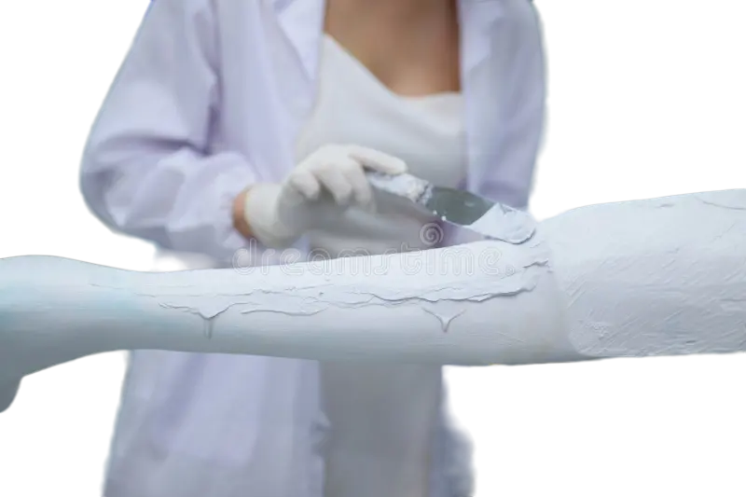
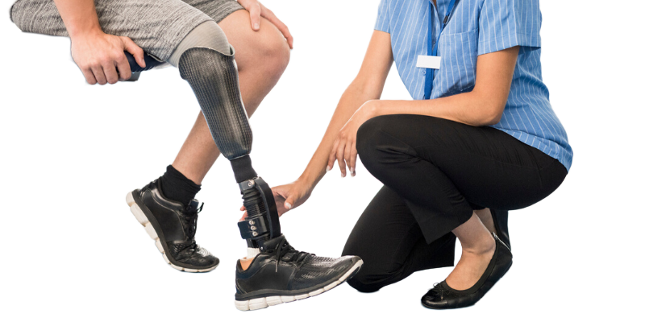

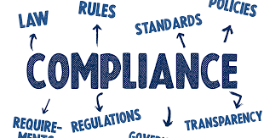
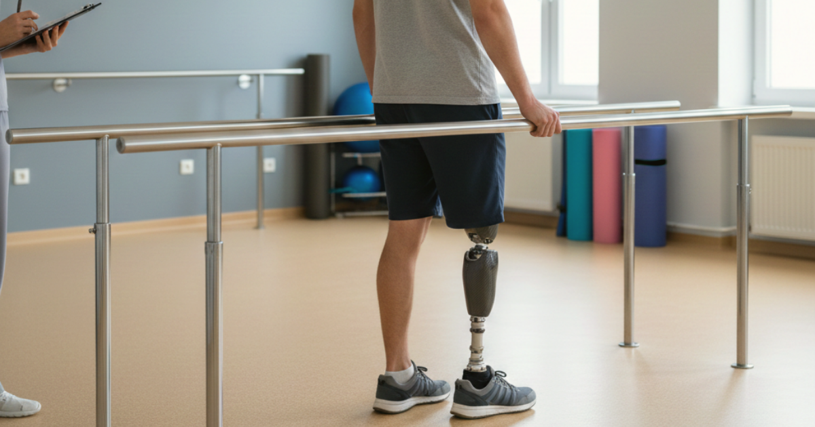
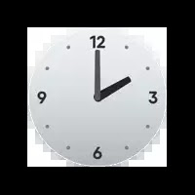
How Much Is Your Time Worth?
Notes:
Clinical Workflow Roadblocks
Documentation: Clinical notes, Correct Coding, Physician letters
Administration: Compliance, Policy, Parts Ordering, Changing Requirements, Audits, Denials, Communication
Fabrication: Plaster Modifications, Lab Travel time, Fabrication expertise
Patient Care: Happy Patients and Clinical Outcomes

Slide 5
Bionic P&O Group’s 1st Key Problem
Growing practice size from 7-10-50 (2016-2025)
Challenges with local fabrication vs. centralized fabrication
Vast experience difference and preference in clinicians
How do we create an efficient sustainable model to deliver efficient and effective care across our groups

Slide 6
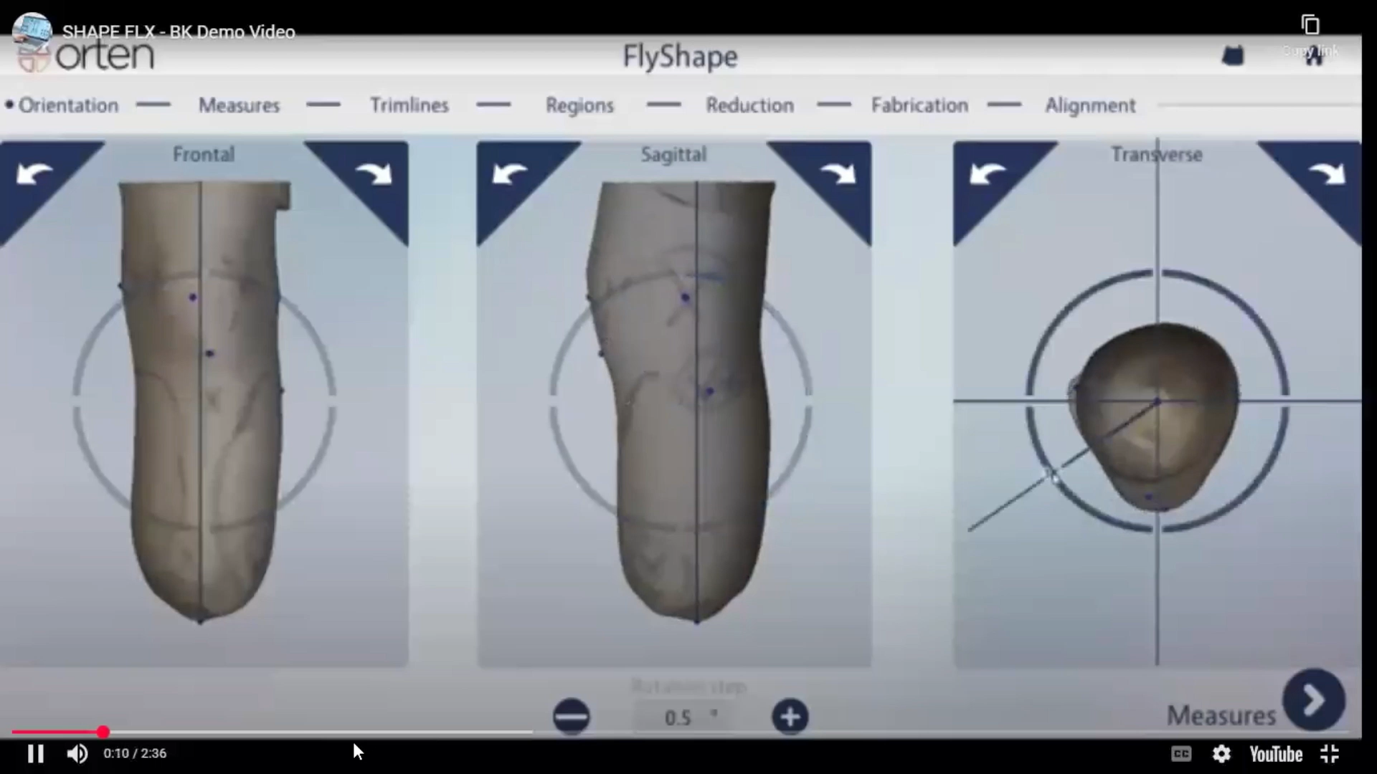
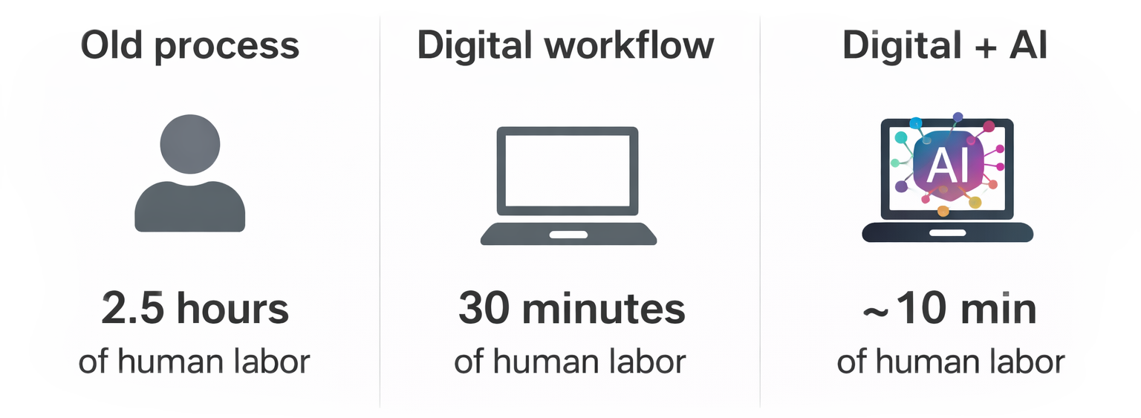
Solution: Digital Workflow and 3D Printing

Slide 7
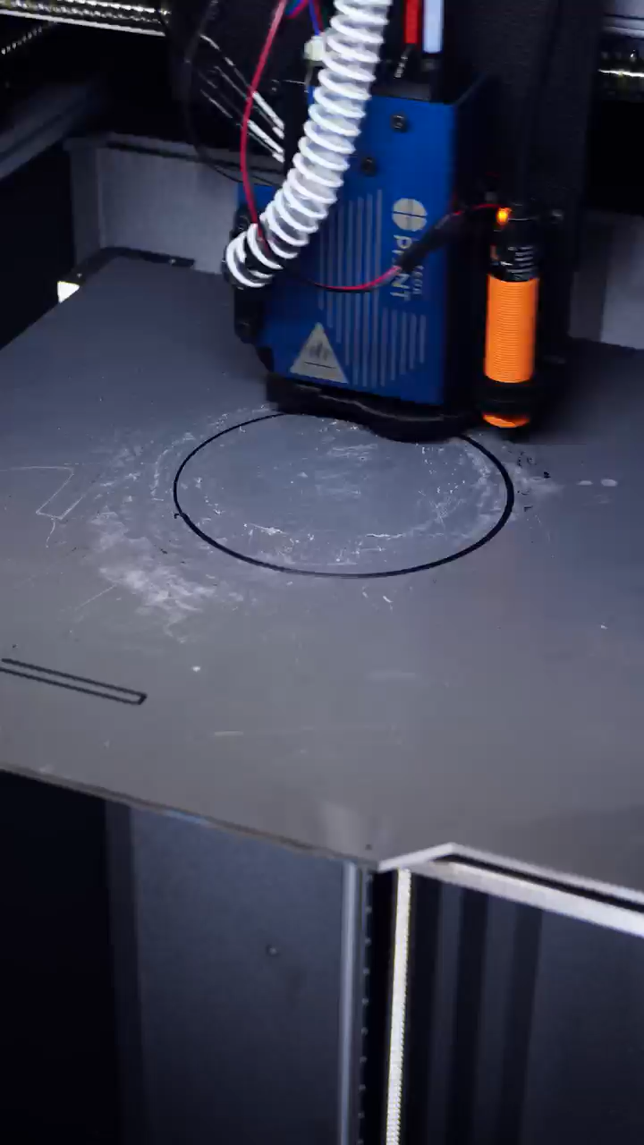
Solution: Digital Workflow and 3D Printing

Slide 8
The Challenge
Clinical Workflow Roadblocks
Documentation: Clinical notes, Correct Coding, Physician Letters
Administration: Compliance, Policy, Parts Ordering, Changing Requirements, Audits, Denials, Communication
Fabrication: Plaster Modifications, Lab Travel Time, Fabrication Expertise
Patient Care: Happy Patients and Clinical Outcomes

Slide 9
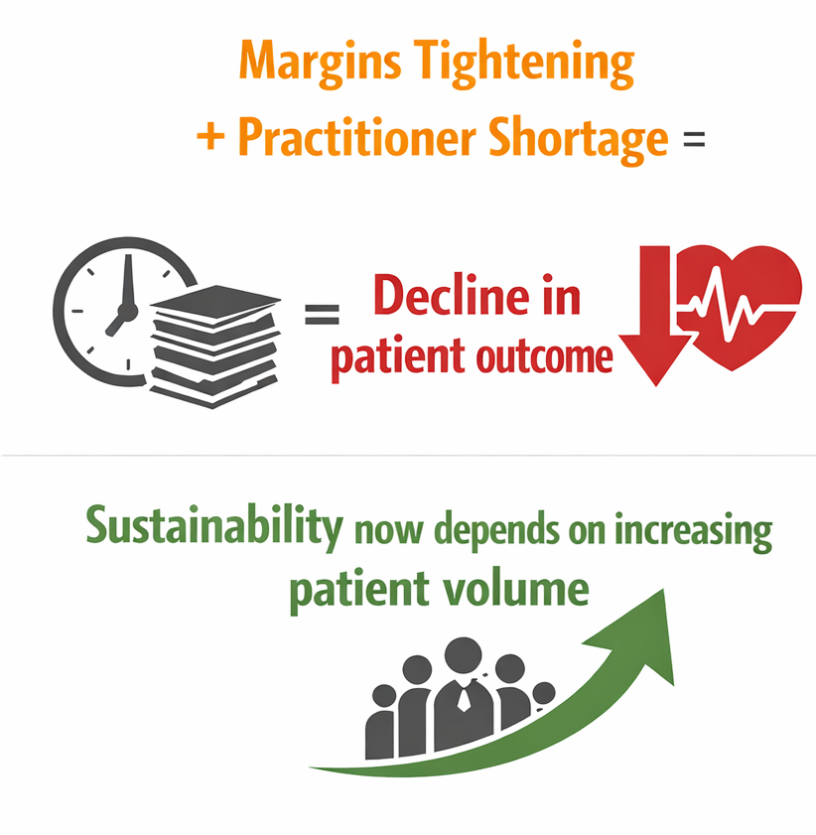
The Volume Reality in Modern O&P

Slide 10
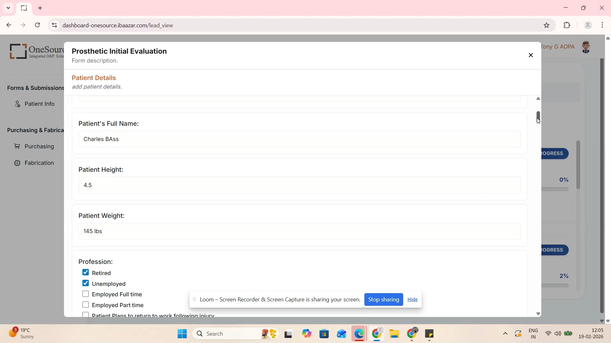
Our Solution
We developed a smart information collection platform that utilizes AI to generate a framework of complex prosthetic medical documentation to support reimbursement of services.
Practitioner administration time dropped ~50% per case, which we reinvested into patient care and outcomes driving our practice.
Notes:
AI-powered documentation platform streamlines complex prosthetic medical documentation for reimbursement
Automated workflow generates clinical notes, L-codes, physician letters, and directs multi-team tasks simultaneously
~50% reduction in practitioner administrative time per case
Reinvested time improves patient care, efficiency, and clinical outcomes

Slide 11
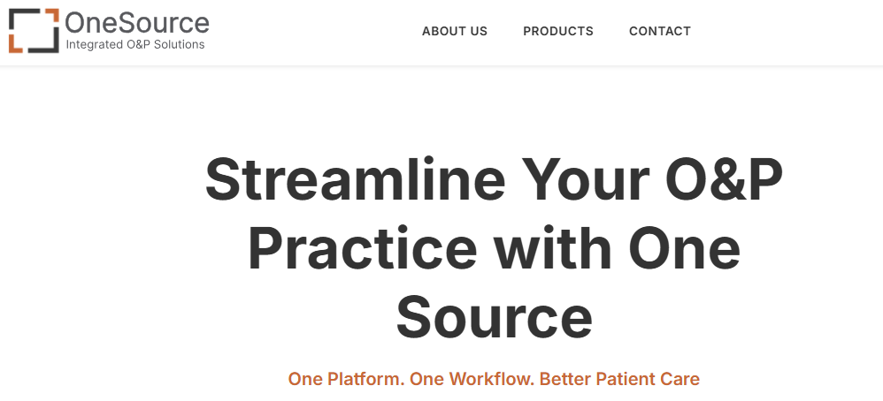
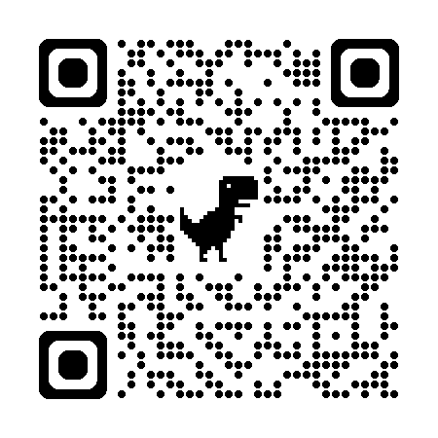
Documentation support
Fabrication integration
Component / Device selection and purchasing
Authorization / Denial support
RCM support

Slide 12
Thank You

Slide 13
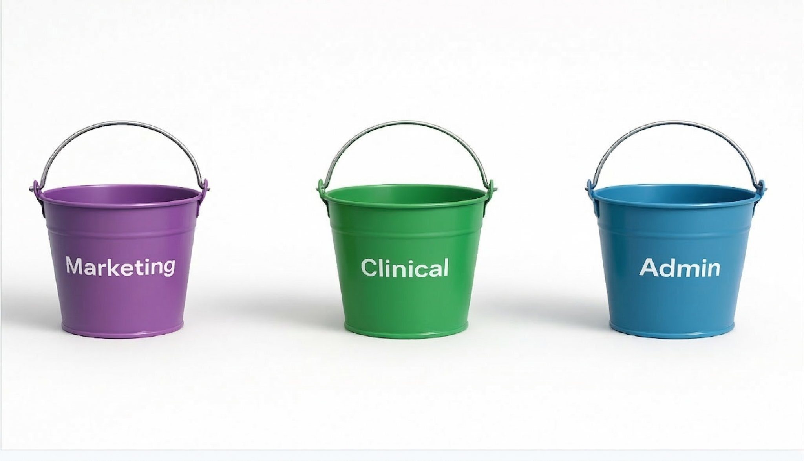

Slide 14
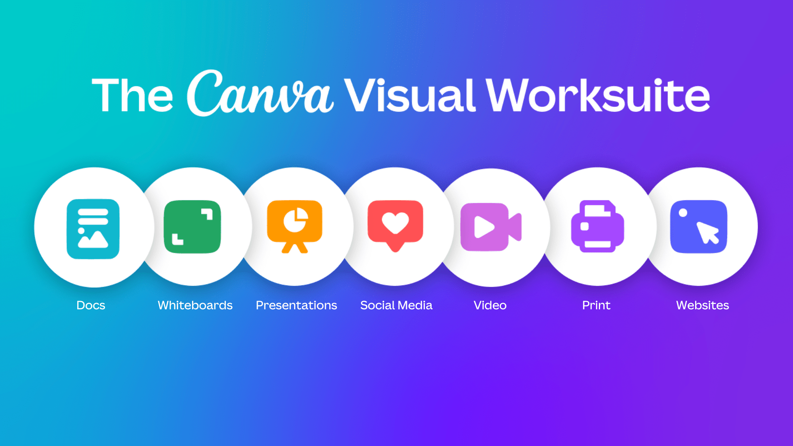

Slide 15
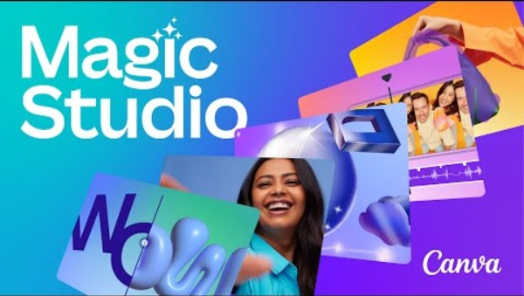
Notes:
https://www.youtube.com/watch?v=bVCRcNlY1yw

Slide 16
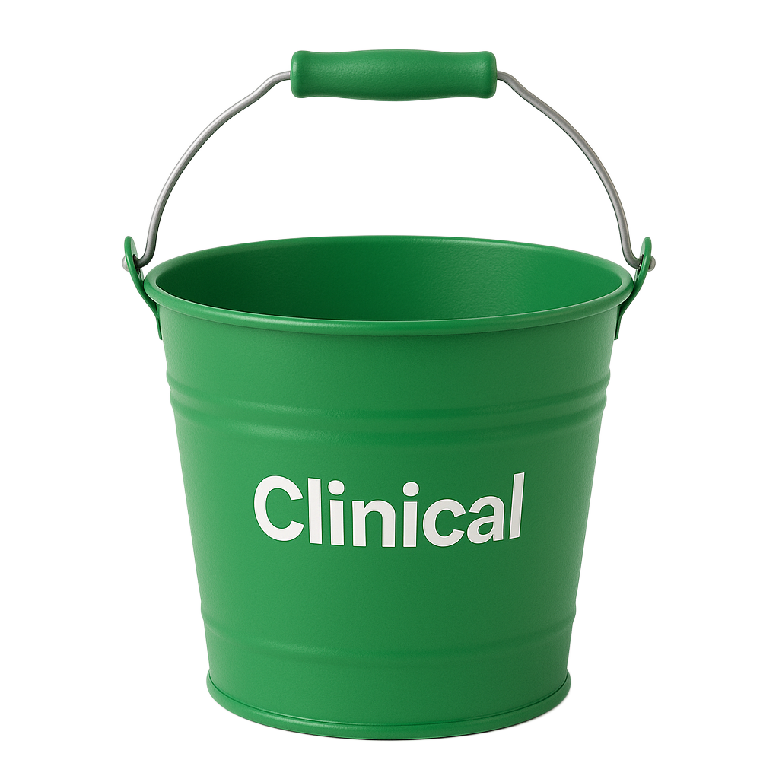

Slide 17
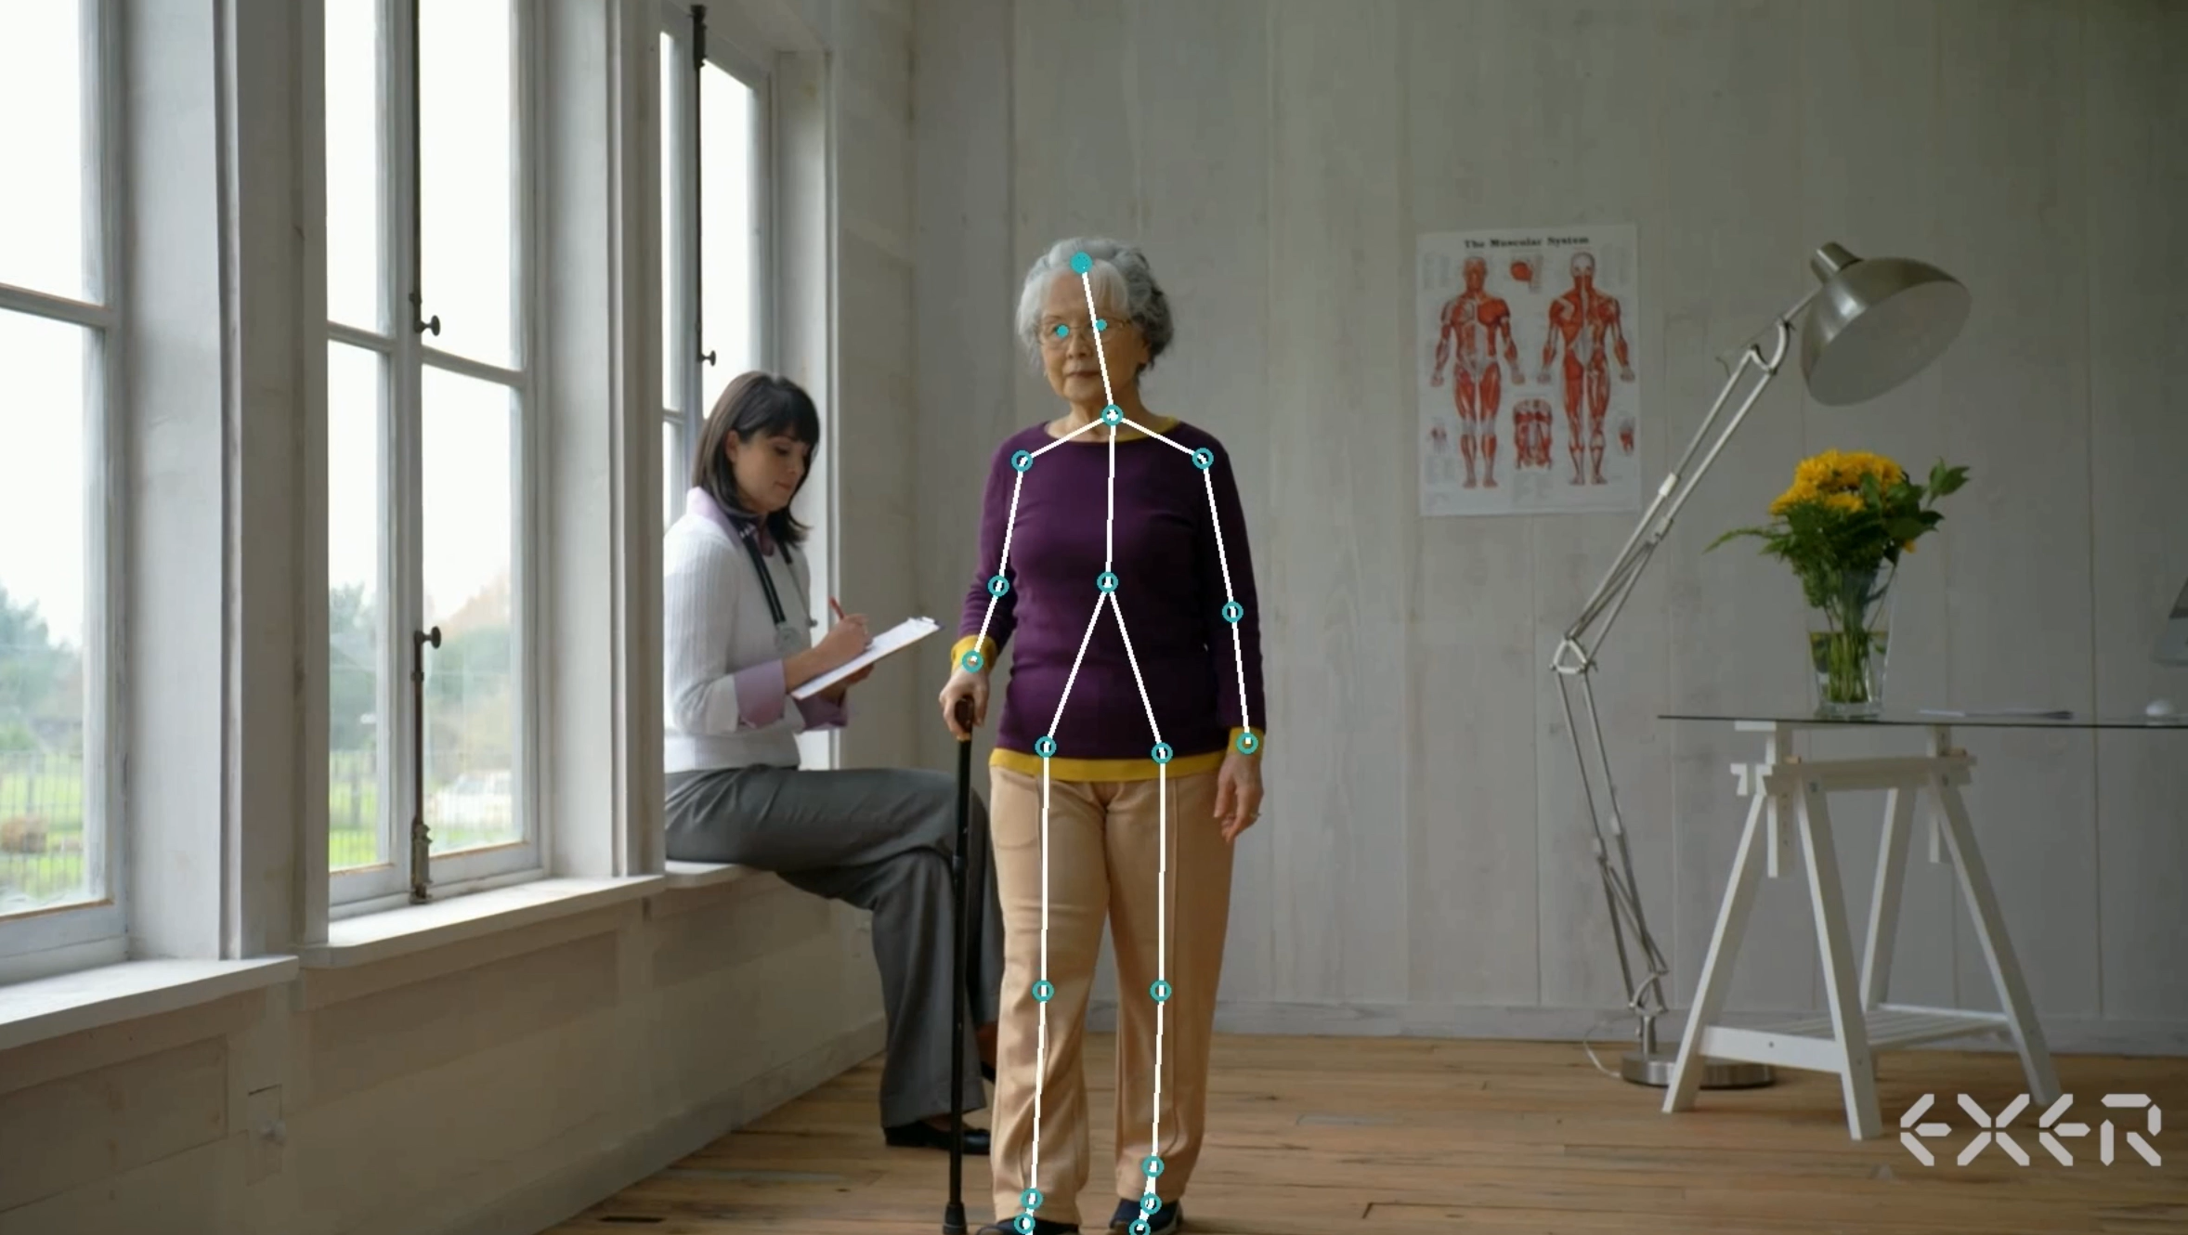

Slide 18
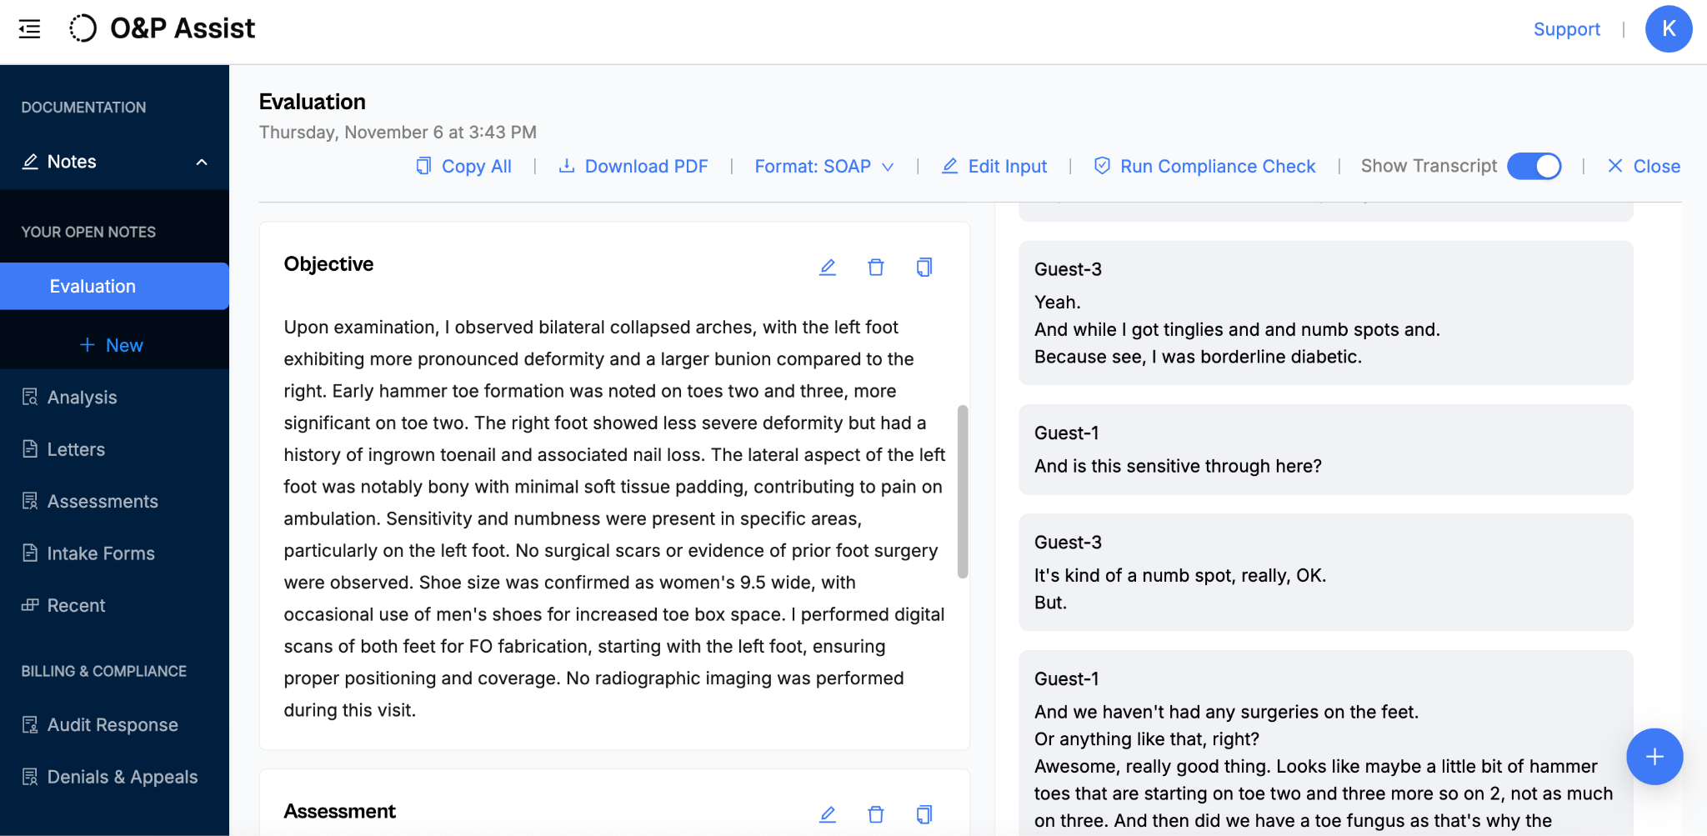
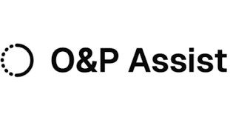
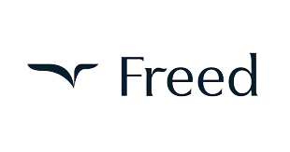


Slide 19
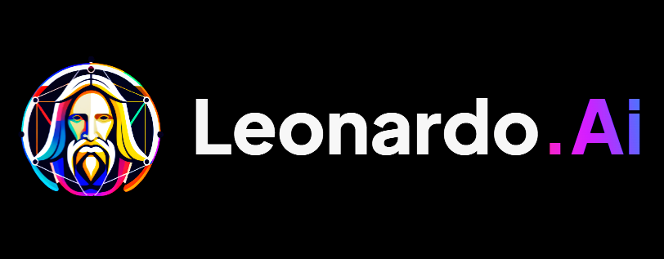
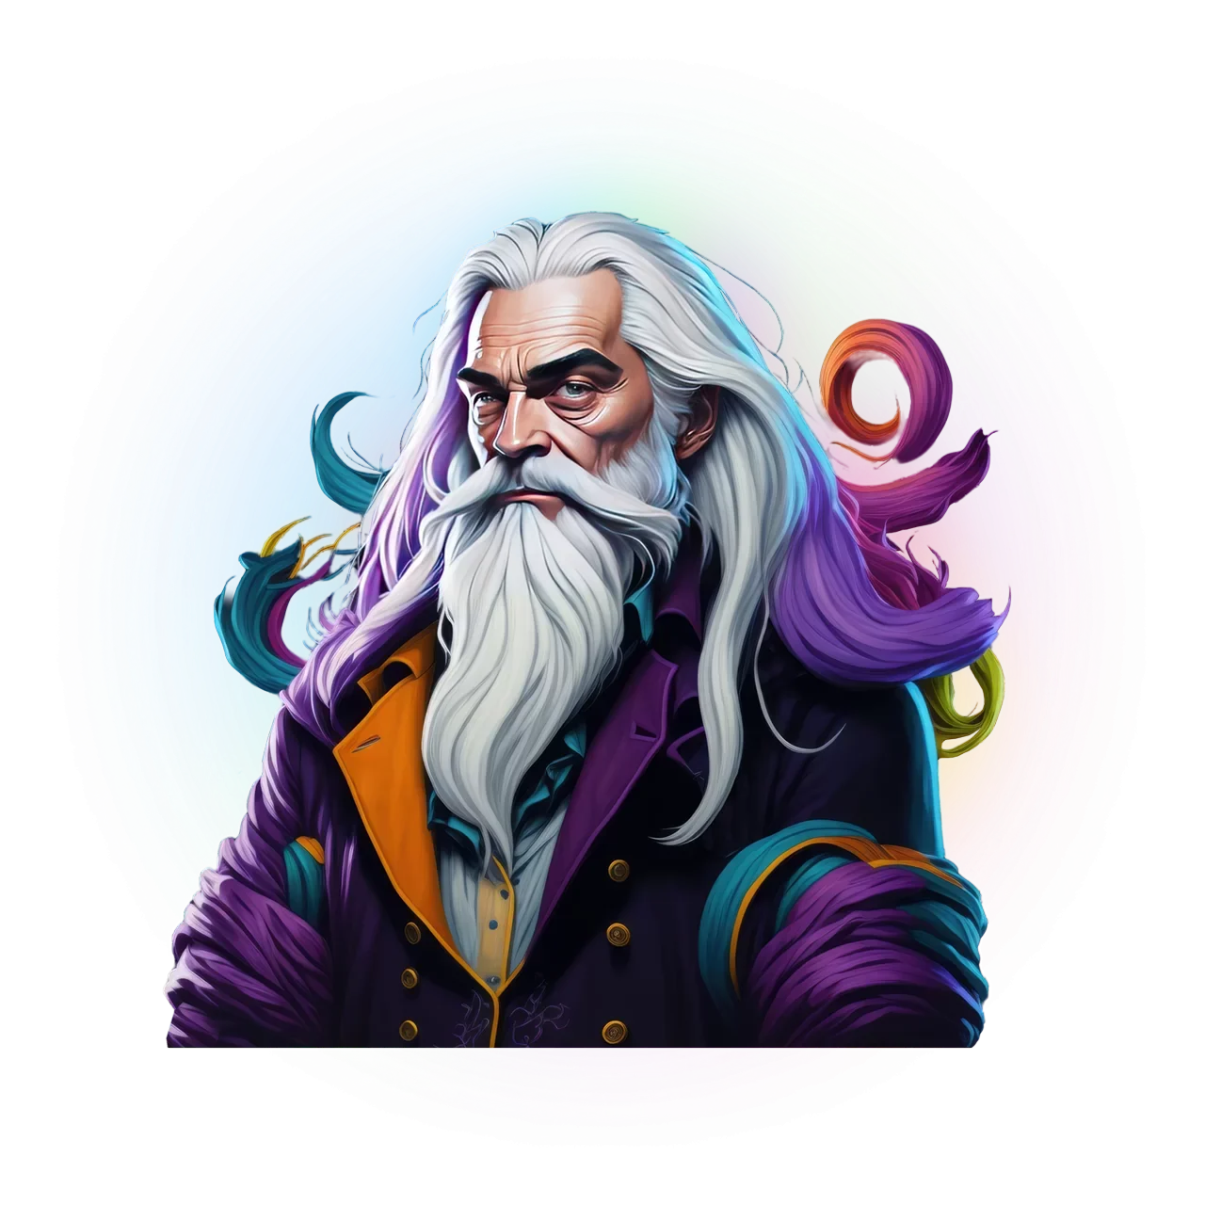

Slide 20
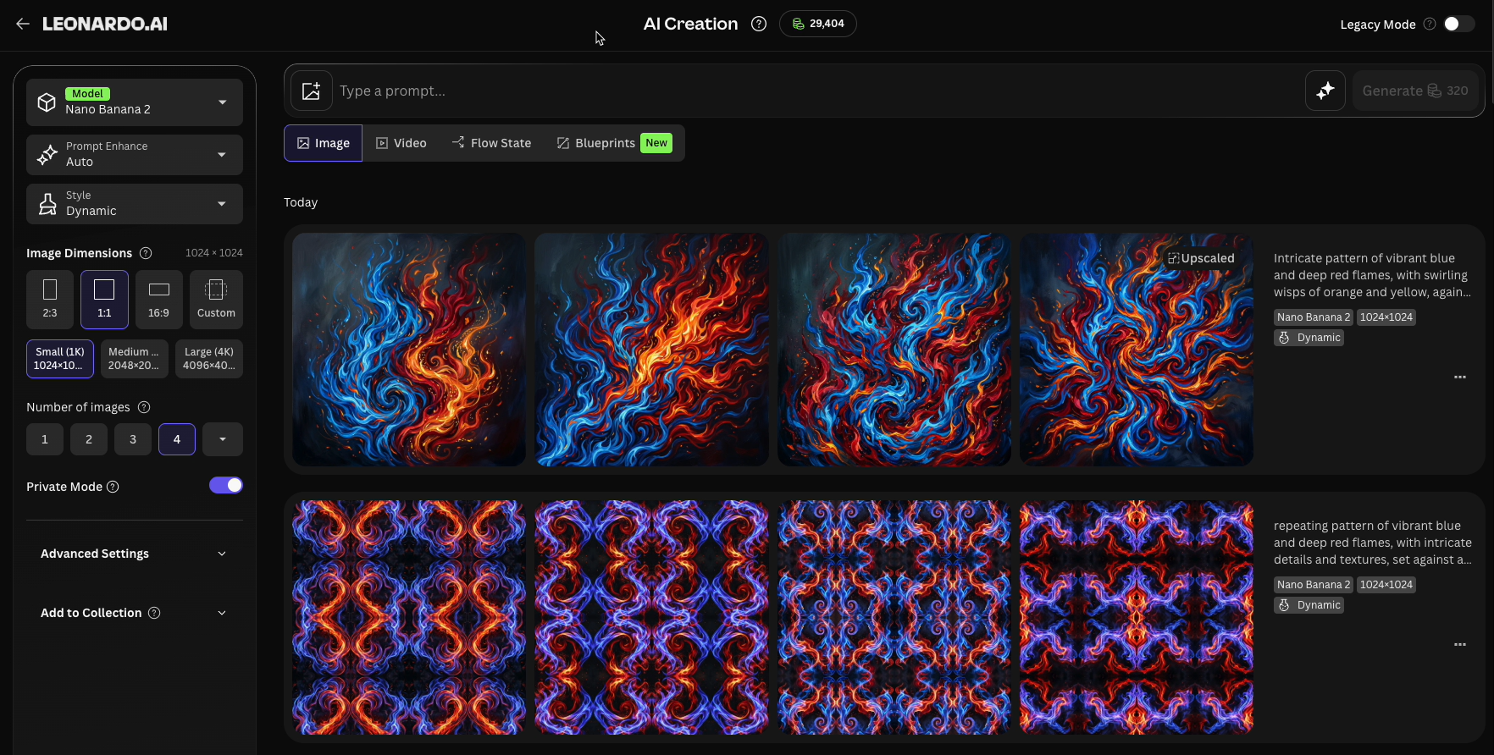

Slide 21
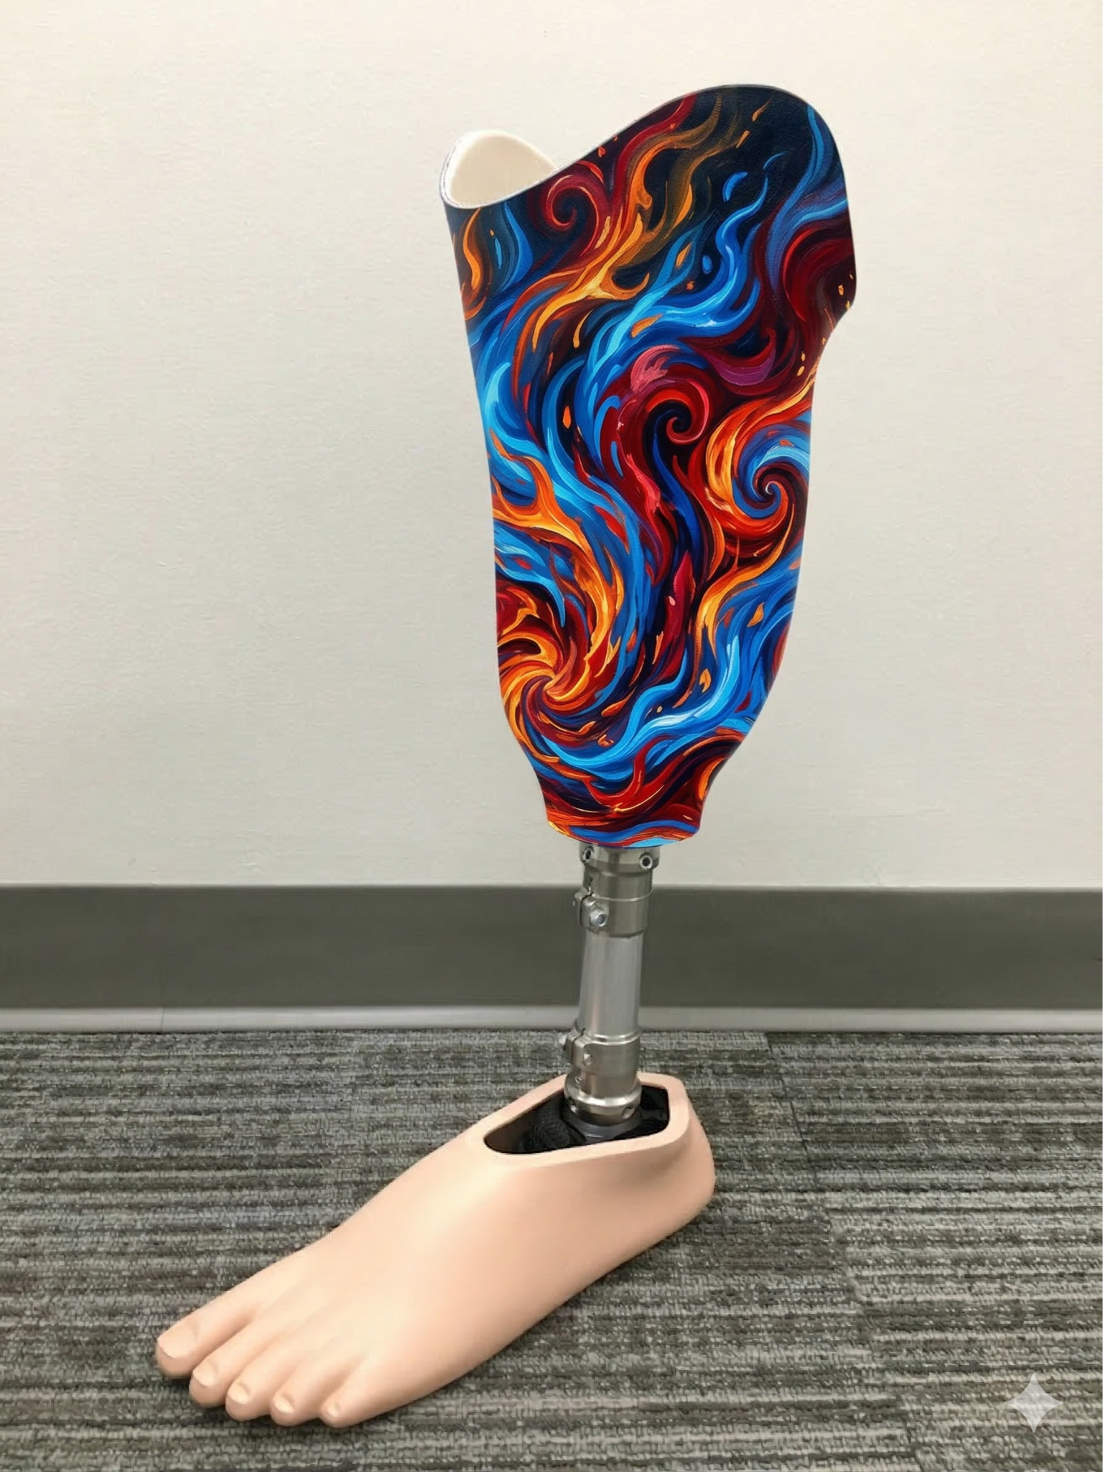





Slide 22
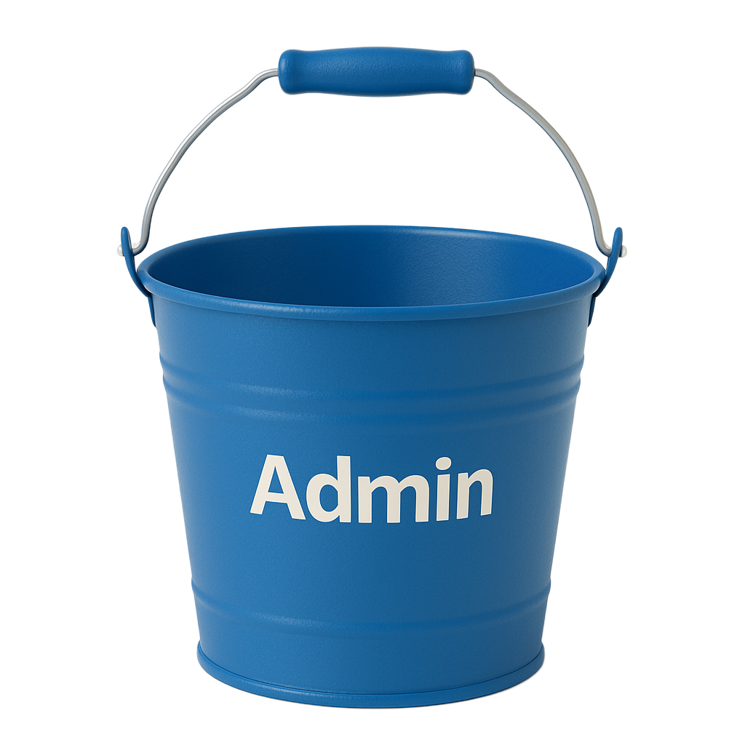

Slide 23
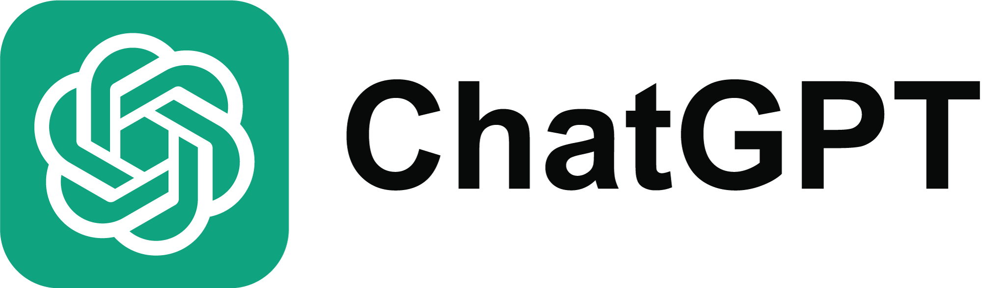
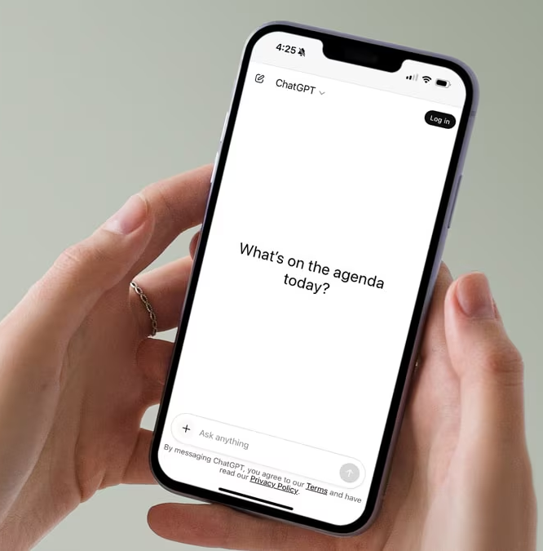




Slide 24

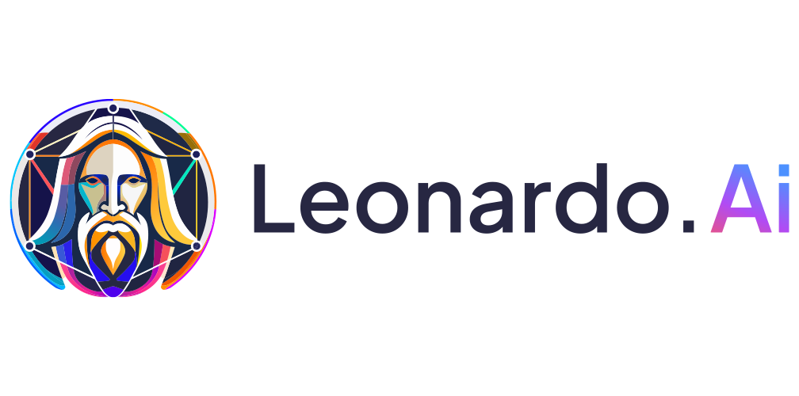


Slide 25

Thank You for Joining

