Slide 1
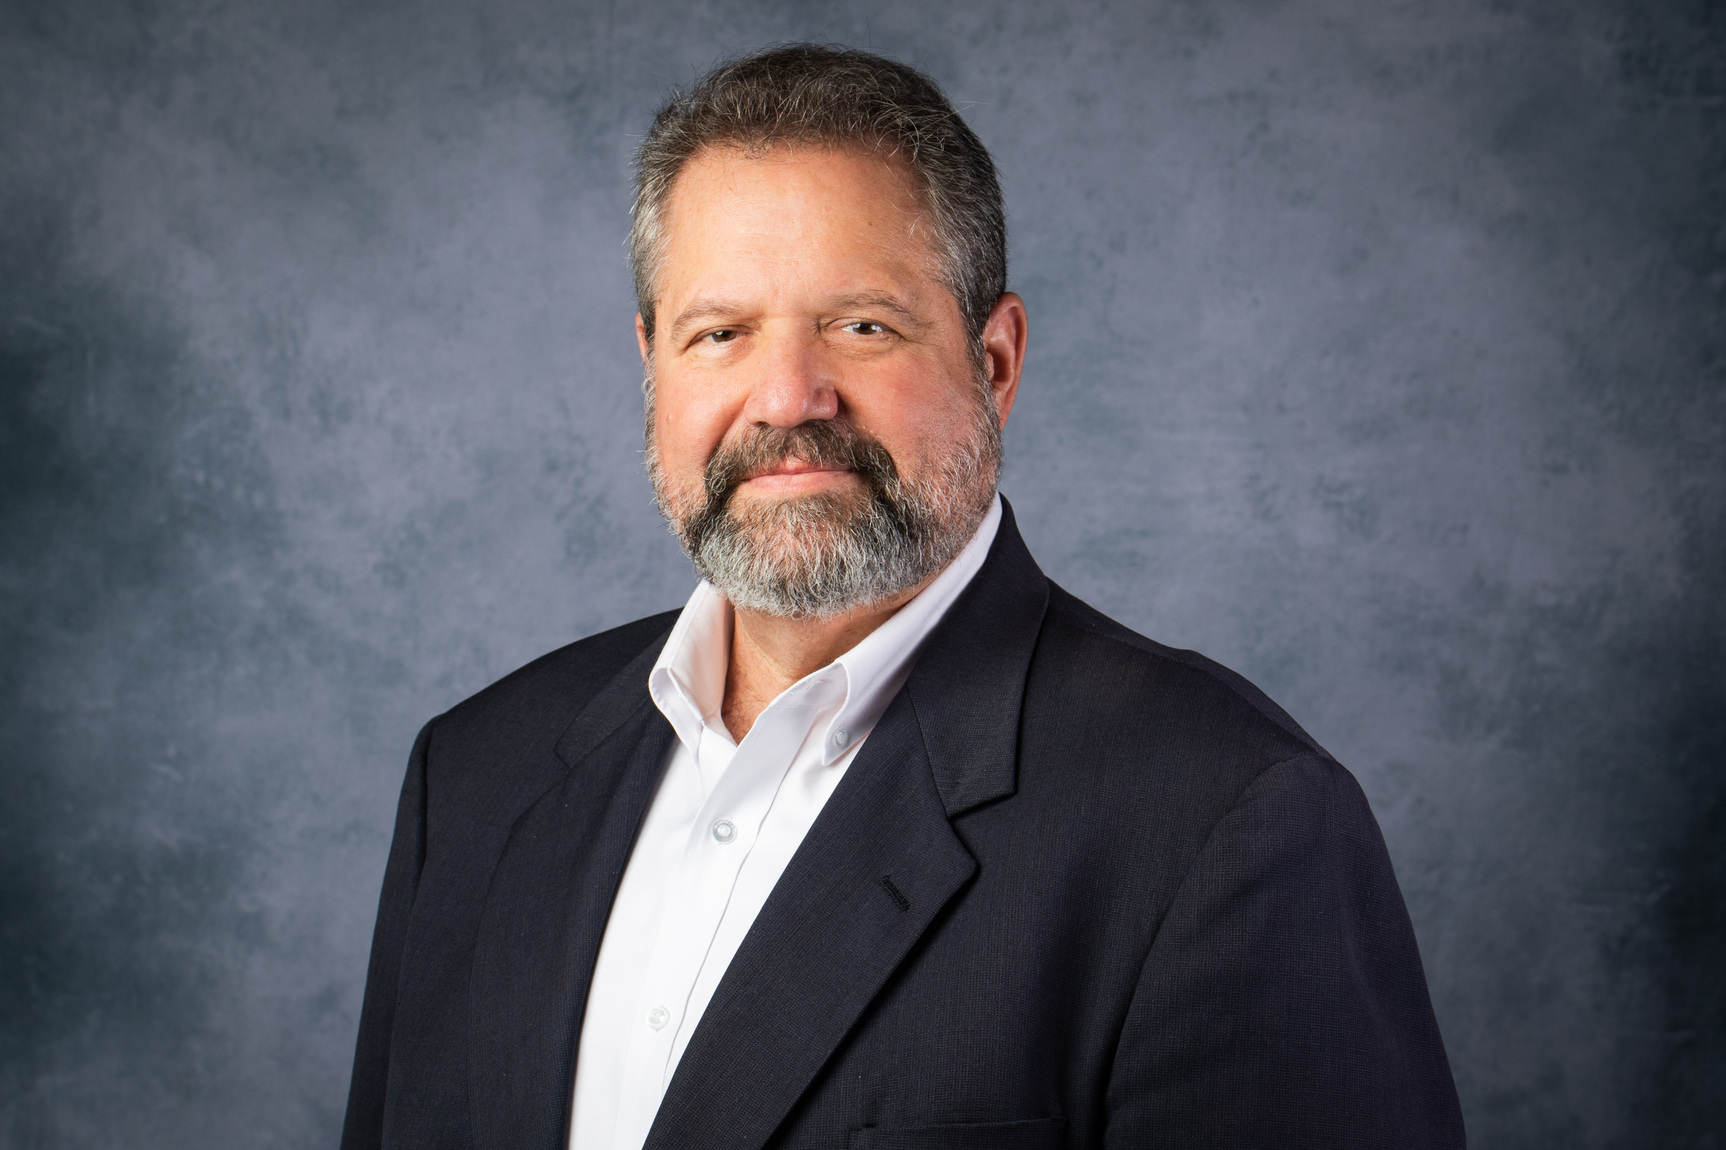
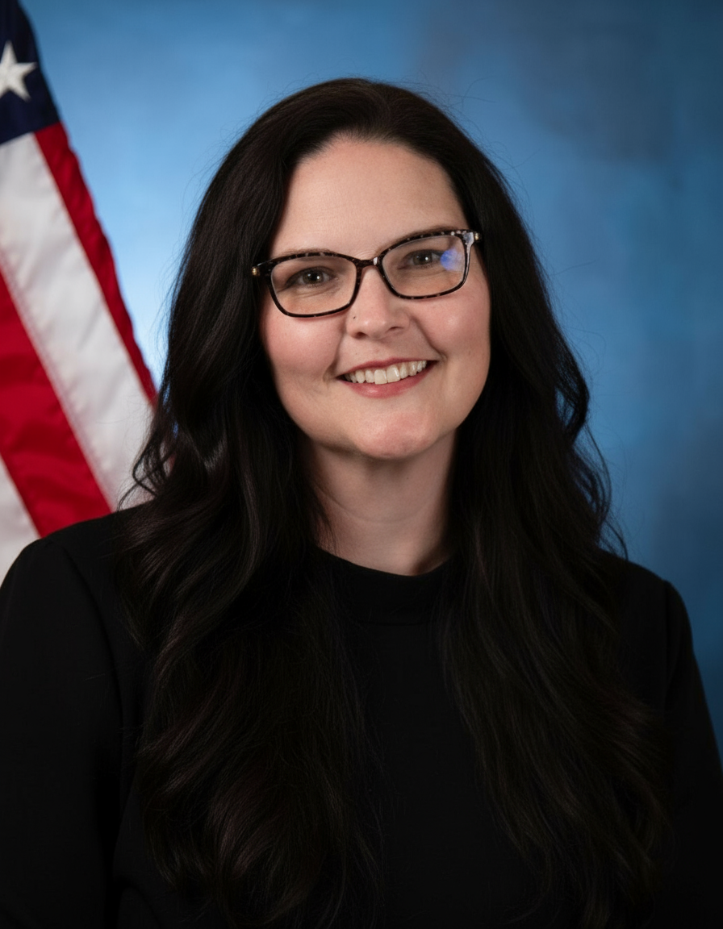
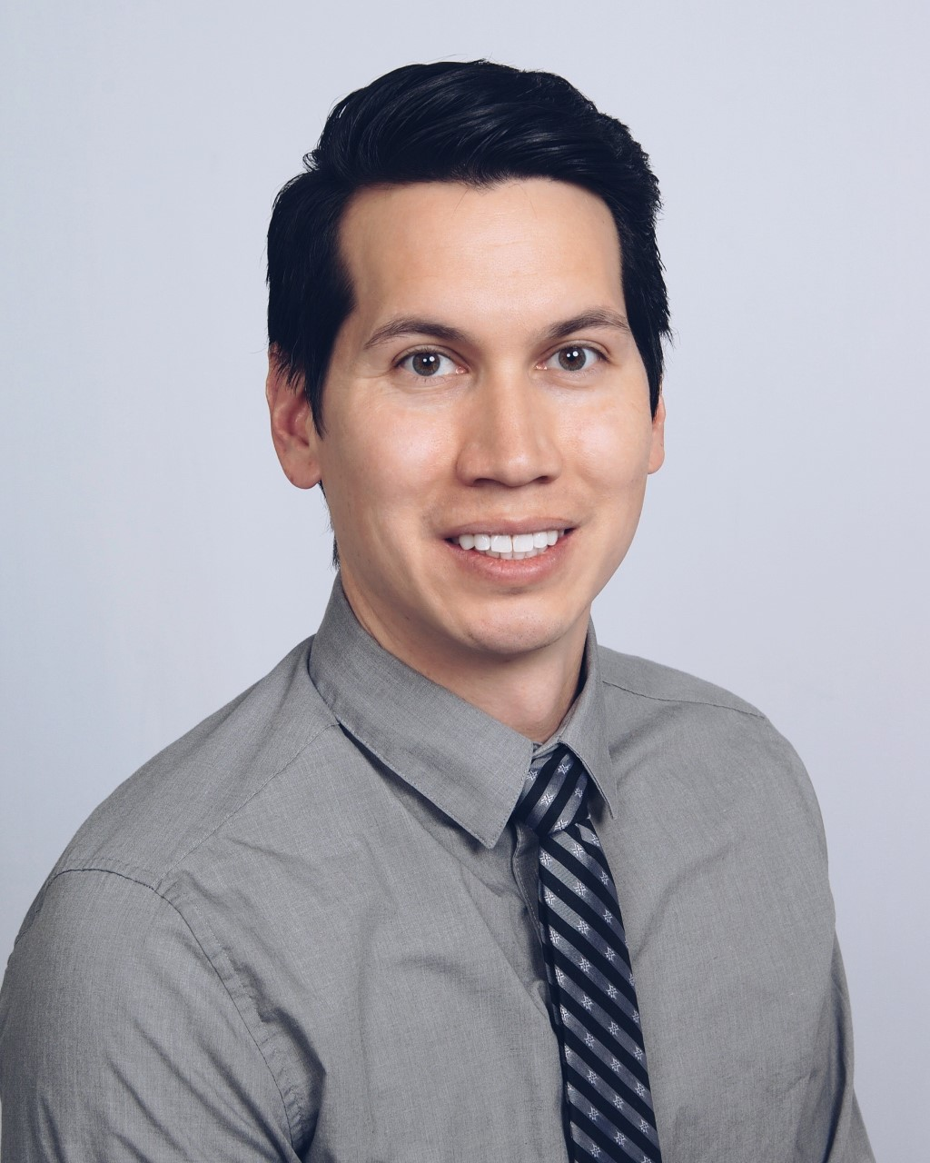
Speakers
Jim Lawson
Heather Benzel, MSN, RN, NE-BC
Jonas Ljung, CPO, MSPO
Manager, Outreach Development
The American Board for Certification in Orthotics, Prosthetics & Pedorthics
Health System Specialist
U.S. Department of Veterans Affairs
Director, Clinical and
Education Services
NCOPE

Slide 2
Age Friendly Health Systems
Journey of the VHA
March 12, 2026
Heather Benzel, MSN, RN, NE-BC
  VISN23 REC ICC Health System Specialist
  Member, VA Age-Friendly Health Systems Steering Committee
Notes:
https://www.va.gov/opa/choiceact/documents/assessments/assessment_a_demographics.pdf

Slide 3
Disclosures and Acknowledgements
I have no associations or relationships to disclose
Thank you to the VA Age-Friendly Team: Dr. Andrea Schwartz, Kayla Lalande, Ines Valencia-Mendoza, Marianne Shaughnessy, the VA Age-Friendly steering committee and champions, GEC and GRECC leaders, and to the John A. Hartford Foundation and Institute for Healthcare Improvement
This talk does not represent the official position of the U.S. government or the VA

Slide 4
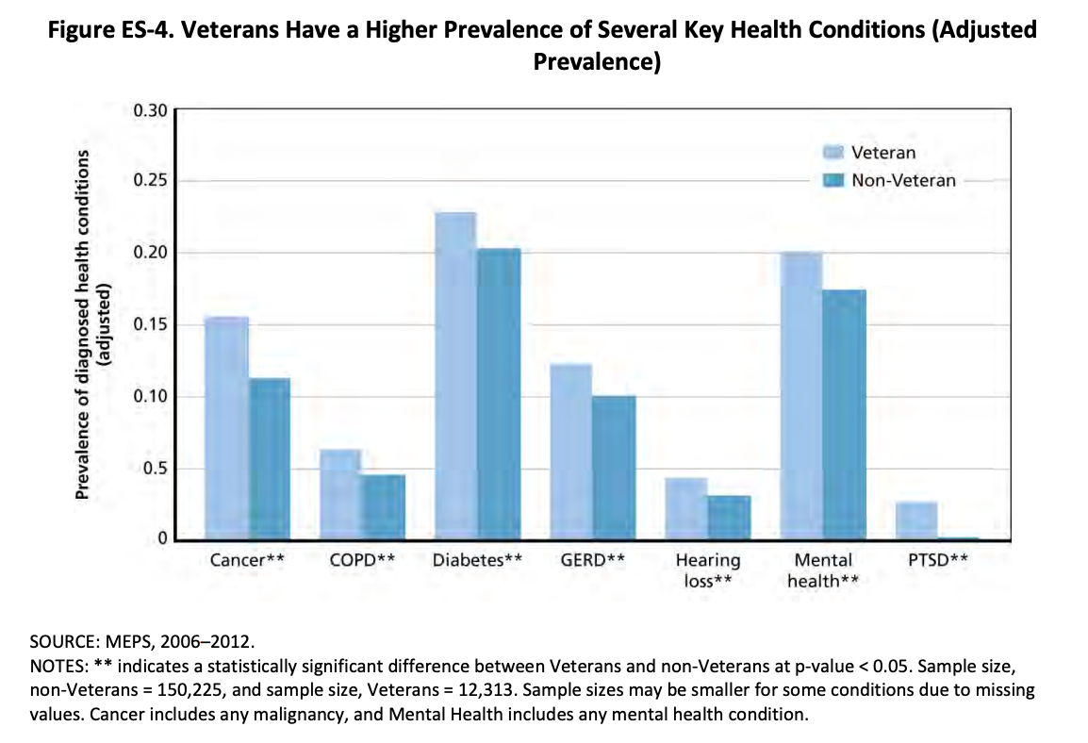
Veteran Population
Age 65 and older
Veteran Population
49%
USA-General Population
16%
Notes:
https://www.va.gov/opa/choiceact/documents/assessments/assessment_a_demographics.pdf

Slide 5


VA Age Friendly Aim: Aligned with HRO
In March 2020, the Office of Geriatrics and Extended Care (GEC) set the aim for VA to become the largest integrated health care system in the U.S. to be recognized by the Institute for Healthcare Improvement (IHI) as Age-Friendly.
Notes:
In March of 2020, the VHA office of Geriatrics and Extended Care set aim for the VA to become the largest integrated healthcare system to be recognized by the IHI as Age Friendly.

Slide 6
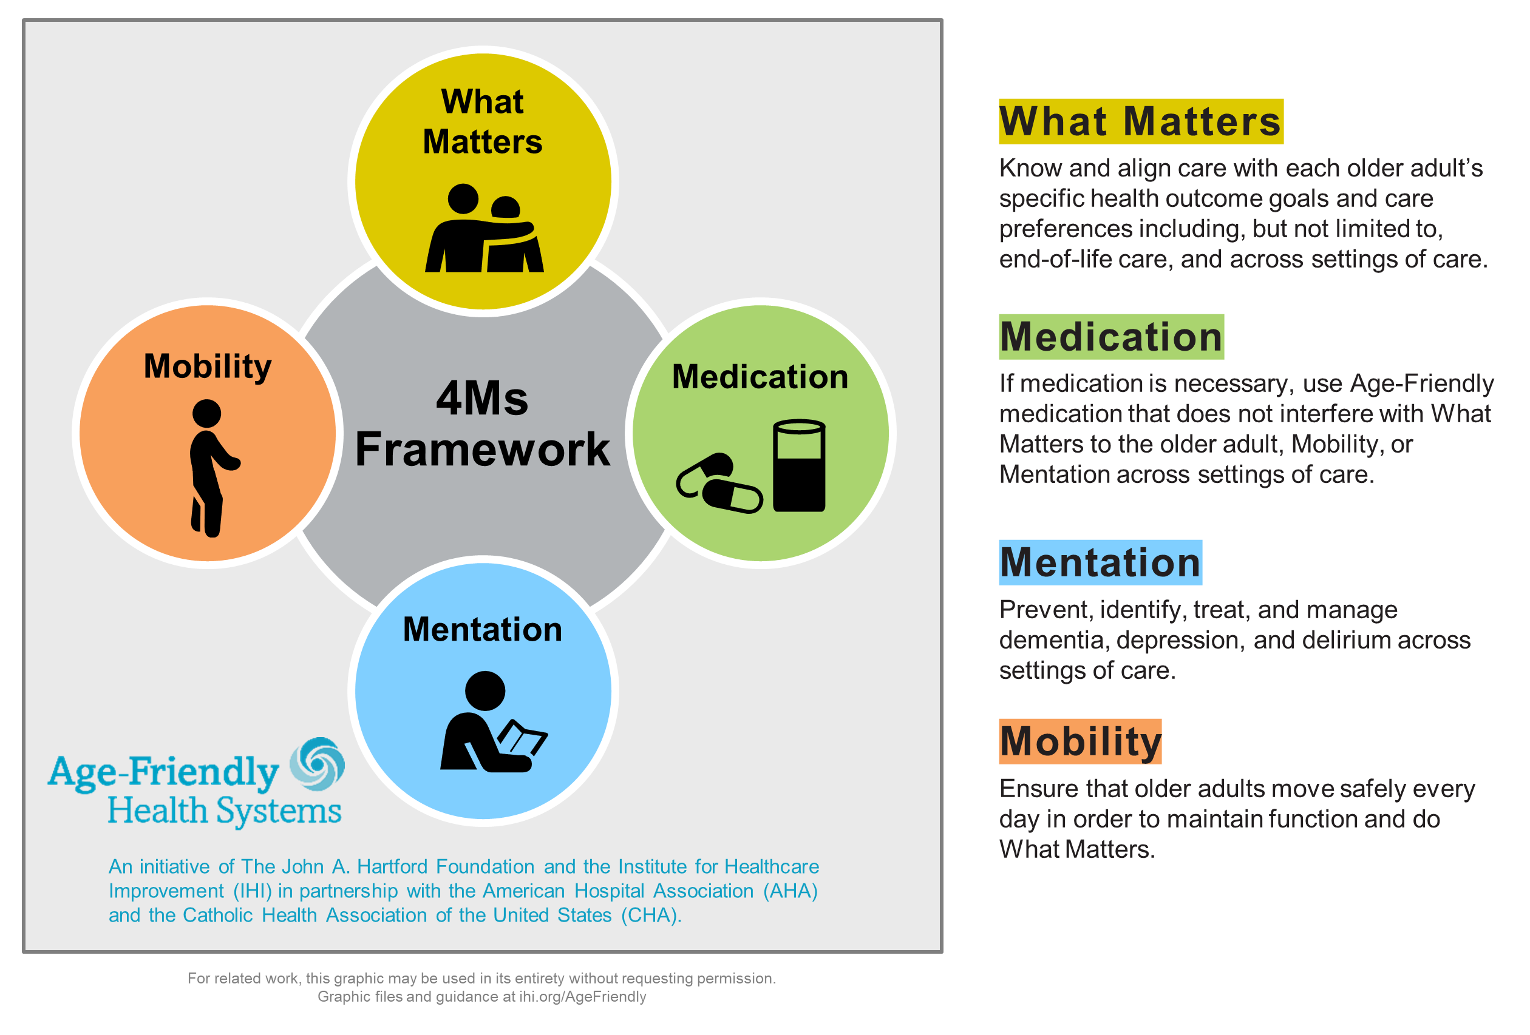
The 4Ms Framework
The 4Ms framework is practiced as a set.
Each “M” affects the others.
4Ms care can be practiced in any care setting.

Slide 7
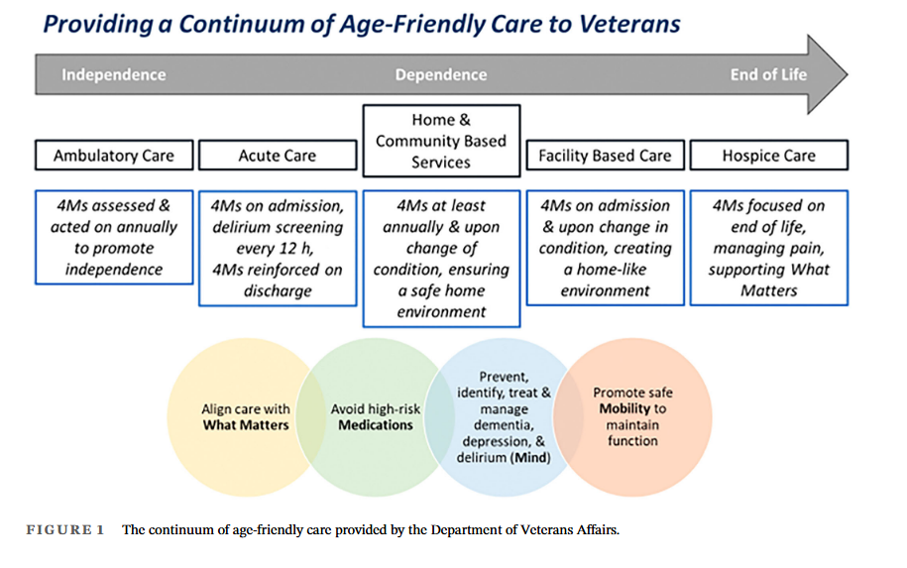
Wozneak and Jindal, JAGS 2024
Notes:
https://pubmed.ncbi.nlm.nih.gov/39422433/

Slide 8
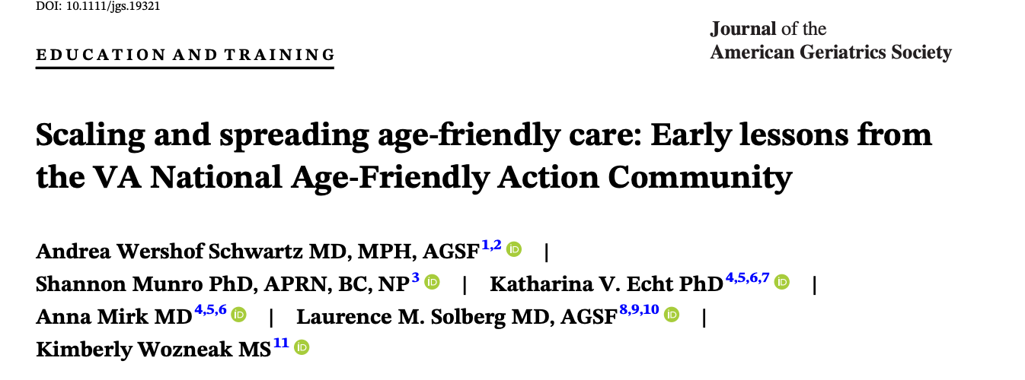



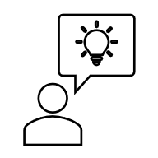

The VA’s AFHS Action Community
Intro to the 4Ms
4Ms Workshop
Team Webinars
CoP Coaching
Recognition
Month 1
Learn about the 4Ms framework
Month 2
A half-day workshop of interactive learning
Months 3-7
Monthly, 1-hour accredited webinars to learn about each of the 4Ms
Months 3-7
Monthly, 1-hour coaching calls with experienced Age-Friendly champions
By Month 7, earn IHI Age-Friendly recognition
Celebrate your success!

Slide 9

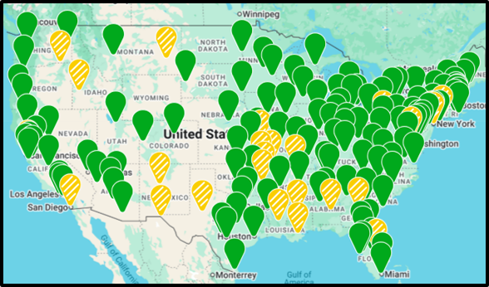


Current VA Age-Friendly Recognitions
496 care settings have earned level 1 AFHS, Participant Recognition from IHI across 164 VA facilities.
325 of those have earned level 2, Committed to Care Excellence.
All VA Health Systems have at least 1 Participant Recognition.
Map Key​
In progress (yellow)= IHI Participant Recognition in 1+ care setting ​
Successful (green)= IHI Committed to Care Excellence Recognition in 1+ care setting
www.ihi.org/partner/initiatives/age-friendly-health-systems/recognized-health-care-sites
Notes:
https://marketplace.va.gov/innovations/age-friendly-health-systems

Slide 10
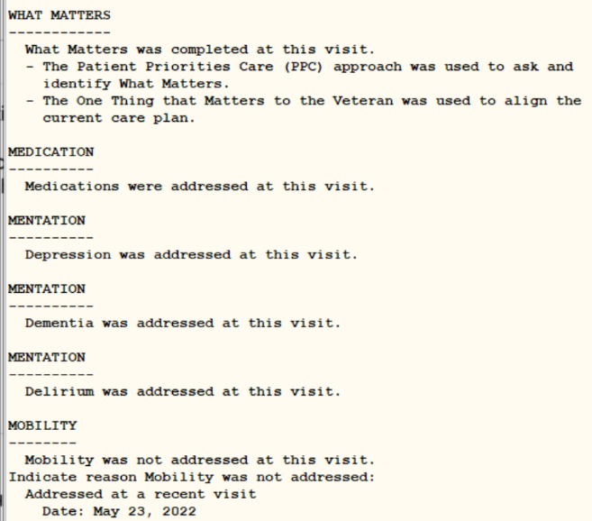
Age-Friendly Documentation in CPRS
A national Age-Friendly 4Ms Note Template is available.
The template is designed to be added to your existing documentation in any care setting from a shared templates folder.
Detailed information on the template: 4Ms Note Template and 4Ms Dashboard
Data from the template is published in the Age_Friendly_Dashboard.
Notes:
The dashboard pulls health factors from the national Age-Friendly 4Ms note template.

Slide 11
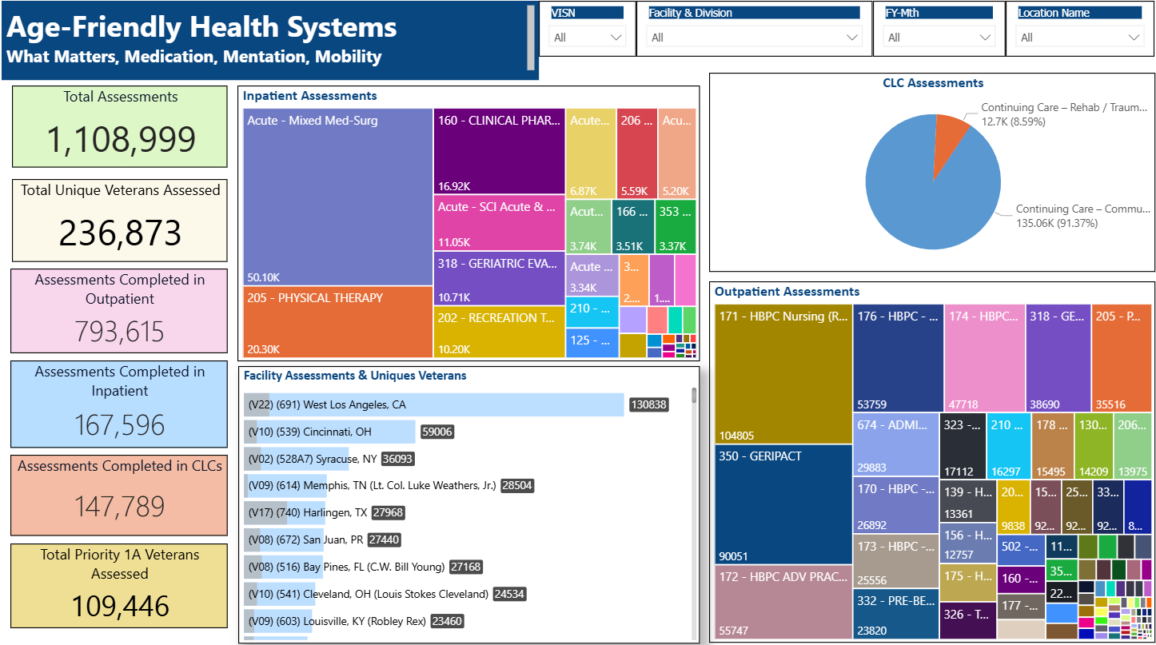
VA Age-Friendly Data/Dashboard

Slide 12
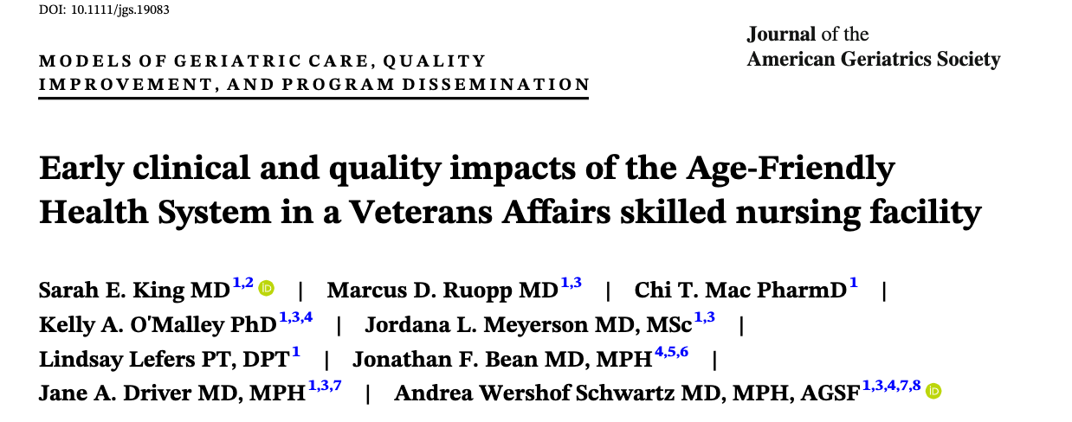
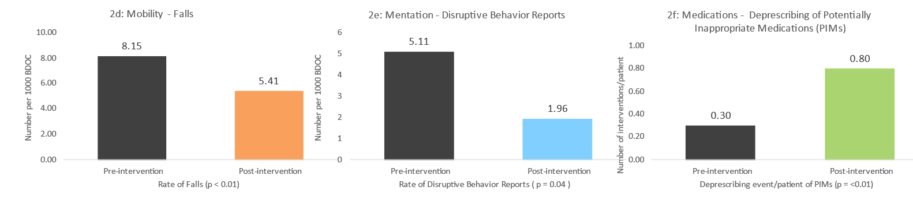
Mobility: Reduction in falls rate
Mentation: Decrease in distressed behaviors
Medications: Increase in deprescribing events/pt
34%
62%
53% Deprescribing
Improvements in falls, behaviors, PiMs
12

Slide 13

Age Friendly Care in Action
Notes:
“This story is such a great reminder that Age‑Friendly care isn’t rocket science — it’s about listening to what truly matters to a Veteran and coordinating the right support around that goal.
In this case, a CLC Veteran at the Sioux Falls VA, shared during his care plan meeting that his Honor Flight was coming up. This was a once‑in‑a‑lifetime opportunity for him — something he’d dreamed about for years — and he was heartbroken at the thought he might not be able to go. (The team knew there was no way he’d be discharged in time)
The team paused and said, ‘Okay, if this is what matters most, how do we make it happen?’ And that’s where the 4Ms came to life. They made small but thoughtful adjustments to his medications (holding Lasix so he could avoid needing to get up multiple times during the flight and preparing med boxes to take with him), prepared the mobility equipment he’d need for a long travel day (swapping bulky equipment for portable, lightweight walker and wheelchair for the day) and focused therapy on building his strength to successfully complete needed transfers during the trip. They coordinated transportation, planned for comfort, and supported his mood and confidence as the trip approached.
None of these steps were complicated on their own. But together, they removed the barriers standing between him and something incredibly meaningful. And because of that coordinated effort, he made the Honor Flight — returning with a huge smile and a renewed sense of purpose which carried over to his motivation for recovery during the duration of his inpatient stay.
This story shows what Age‑Friendly care really is: small, intentional actions centered around what matters most to the Veteran — and the impact can be absolutely life‑changing.”

Slide 14
Aging.
So Cool.
Everybody’s Doing It.

Slide 15

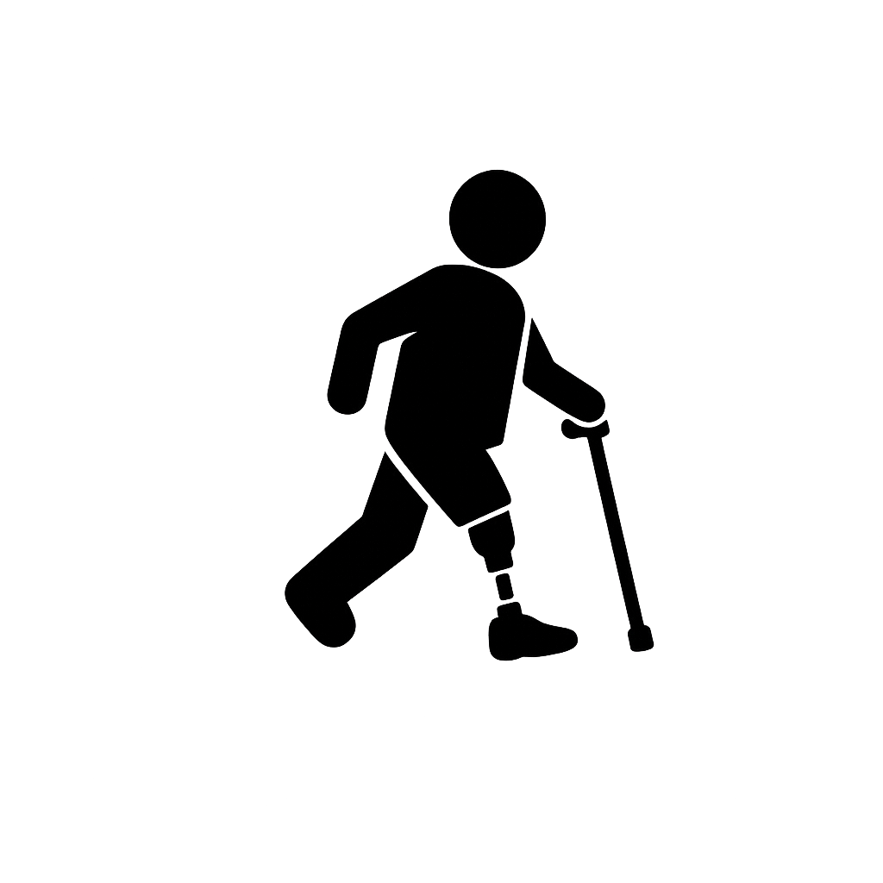
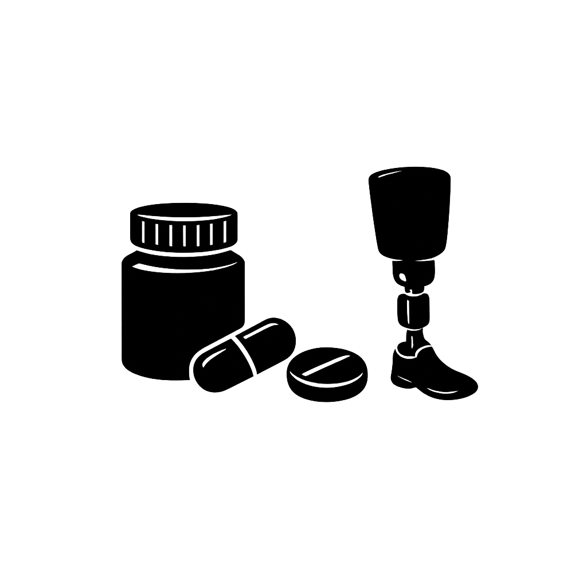

Using the 4Ms to Think Differently About O&P Care for Aging Adults
POP Talk
Jonas Ljung CPO, MSPO
March 12, 2026
Notes:
Working with students and residents at NCOPE has always got me thinking about what I wish I knew earlier in my career.
Not a new material. Not a new component or device. But a better way to organize my thinking when working with older adults.
Looking back, I realize I was often doing the right things — but maybe not always in the right order.
What I want to share today is an application of the 4Ms framework that gives structure to things many of us already do intuitively — to help make aging adult care more consistent, safer, and more patient‑centered.

Slide 16
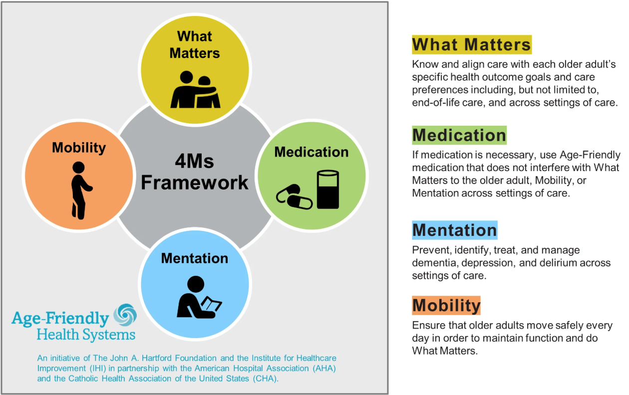
Notes:
Heather already provided a great overview of the VA’s approach to age-friendly health systems and the 4Ms framework, so I will not repeat what you already know!
Instead, my job for the next ten minutes is simple: to relate the 4Ms directly to orthotics and prosthetics — the way we evaluate, design, deliver, and follow up with our older adult patients.
Looking back at my 15 years of patient care, if I was able to apply the 4M framework as a whole both methodically and deliberately, I believe many of those challenging cases would have been made easier if I hadn’t just missed one of the Ms!

Slide 17
What Matters (the most underused tool in O&P)
Stop thinking in devices and diagnoses
Align care with an older adult’s goals and preferences
Common “What Matters” goals in geriatric O&P
  Reduce fear of falling
  Independent toileting
  Stand independently for cooking
  Walk to mailbox, church, community activities
The device is not the outcome – the patient’s goals are
Notes:
Let’s start with the first M: What Matters.
In the 4Ms, “What Matters” is about aligning care with the older adult’s goals and preferences — not our default goals.
Here’s an O&P truth: we’re trained from school to the clinic to think in terms of diagnoses and devices. The 4Ms asks us to think in life goals.
With older adults, “success” is rarely “I want to walk better.” In reality, It’s more like:
“I want to get to the bathroom at night without falling.”
“I want to stand long enough to cook dinner for my family.”
“I want to be able to go to church again without being pushed down the aisle in a wheelchair.”
And if we don’t ask our patients what their goals are, and how they will measure their own success, we risk designing and delivering the right device for the wrong outcome.
Two patients can walk into your clinic with a diagnosis of diabetic neuropathy and a history of skin breakdown. Both have a prescription for a custom AFOs. So same diagnosis, same prescription.
But what matters may be different:
One patient may want to be able to safely walk outside and maintain their independence.
So maybe we are fitting this patient with a dynamic energy storing AFO, multiple heel wedges for different shoes, referring them to physical therapy and scheduling follow ups every 3 months to check for adverse skin issues due to motion.
The other wants to transfer safely at home and reduce fear of falling.
So maybe we are fitting this patient with a solid ankle AFO for maximum stability, teaching their caregiver to regularly check their skin and following up once a year to ensure the integrity of the device and to change straps.
Same “problem list.” Totally different design priorities, training plan, and follow-up.
Here’s the practice change we can make — and it’s tiny:
Add one sentence to every eval, and document it:
“What are you hoping this device helps you do that you can’t do now?”
Then at follow-up, judge success against that — not just ask are you having “any rubbing?” and “are you wearing it?”
If we don’t define what matters, we end up optimizing the device — not the patient’s life.

Slide 18
“Not my scope,” can be a safety problem
Medication effects can change risk and outcomes for older adults
O&P relevant impacts
  Dizziness
  Sedation
  Skin fragility
  Delayed feedback
  Tolerance changes
Simple clinical check
  Any changes in medication?
  Any new dizziness, sleepiness or balance issues?
Notes:
Second M: Medication.
The 4Ms calls out that medications can impact older adults in ways that affect function and safety — and can even interfere with the next two Ms mentation and mobility.
Now, we obviously don’t prescribe meds in O&P — but medication effects absolutely effect our treatments and show up in our outcomes.
Here are some medication-related patterns most of us see when we treat older adults, even if we don’t label them that way:
Dizziness or sedation — patients are at a higher fall risk right when they’re learning to use a new device, so additional external factors must be considered.
Neuropathy management — changes in pain perception can change how quickly skin issues are noticed.
Blood thinners — bruising or skin fragility can quickly become a fit/tolerance issue.
Long-term steroid use — similarly, tissue tolerance and healing risk associated with steroid use can change our “acceptable” pressure decisions.
In this case, let us think about the older patient who falls after being fit with a new prosthesis. We could spend weeks and multiple appointments in the parallel bars tweaking alignment, when the real change was a new sleep medication which made them lightheaded and dizzy whenever they transition from sitting to standing.
Here’s the practice change — two questions:
At every appointment, ask:
“Have there been any medication changes in the last month?”
And “Have you experienced any new dizziness, sleepiness, or balance issues?”
If they say yes, you don’t need to panic — just adjust. Slow the progression, reinforce assistive device use, consider PT/OT collaboration, and tighten your follow-up schedule.
Medication doesn’t live outside our scope — it lives inside our safety plan.

Slide 19
Mentation: Non-use ≠ Non-compliance
Cognition, mood and memory
Non-use can be a mismatch between cognitive load and the device provided
  Simplify the device
  Simplify the routine
  Involve a caregiver
  More frequent follow-ups
Teach-back
Notes:
Third M: Mentation — our patients’ mind and mood.
The framework emphasizes paying attention to cognition, mood, and changes that can affect outcomes.
In O&P, mentation shows up as:
“A patient not remembering how to don/doff.”
“Not reporting skin issues until they are severe.”
“Or not wearing the device leading us to think they must be non-compliant.”
But a lot of that isn’t necessarily “non-compliance.” It’s a mismatch between cognitive load and what we fit them with.
We’ve all seen it: an older adult with a history of stroke, mild cognitive impairment, and depression — we deliver an orthosis with multiple steps, multiple straps, and a complex break-in schedule. They nod in clinic, then it all falls apart at home, figuratively and sometimes literally. That’s not a bad patient. That’s a design and training miss.
Here’s the 3rd M practice change:
Try using a teach-back method at every delivery.
Instead of asking the question, “Do you understand?” say:
“Show me how you’re going to put this on when you’re at home.”
If they can’t demonstrate it, that’s not a failure — it’s just more information.
Then we have options: we could simplify the orthosis, simplify the routine, involve a caregiver, provide written/visual steps, or schedule more frequent follow-ups.
Mentation isn’t a label — it’s a design constraint, we have to consider for every patient.

Slide 20
The world does not have parallel bars
The device is only one part of the mobility prescription
Walking in clinic ≠ real world mobility
  Thresholds, curb-cuts, low light, footwear changes
30-second mobility safety check at delivery
  Where will you walk first at home?
  What shoes will you wear?
  What assistive device will you use, where and when?
Notes:
Fourth M: Mobility emphasizes keeping older adults moving safely because it supports function and helps them do what matters.
Obviously at its core, O&P is built around mobility — but the 4Ms framework pushes us to go beyond “the patient walked 50 feet in the clinic.” Because clinic walking is not real-life mobility.
Real-life mobility is:
uneven thresholds
crossing the street when the red hand is blinking
bathroom trips in the middle of the night
changing shoes depending on the outfit you are wearing
carrying groceries
fatigue
A prosthesis can be beautifully aligned, and an AFO can be perfectly tuned — but if we didn’t address transfer strategy, footwear, and assistive device integration, mobility risk can stay high.
Here’s a practice consideration for the 4th M — a 30-second mobility safety check at delivery:
Ask three quick questions:
“What is the first thing you are going to do when you get home?”
“What shoes will you wear with this?”
“What assistive device are you using, and when?”
Then set a safe accommodation plan.
If your patient has a fall history, dizziness, or a major mobility change, normalize collaboration: “Let’s pull in PT” or “Let’s coordinate with OT.” The referral pathway outside our profession, is risk management and quality improvement, not extra work.
Mobility doesn’t start at the parallel bars — it starts when the patient gets home.

Slide 21
Apply the 4Ms to every aging patient
What Matters: What goal are we supporting?
Medication: Any changes affecting safety today?
Mentation: Can the patient learn/remember/report?
Mobility: Are they safe in their environment?
Pick one “M” to strengthen this week
Notes:
Now, here’s the part I want you to take home: the 4Ms work best as a single mental checklist you can apply to every older patient interaction.
The Age-Friendly Health Systems goal is reliably providing the 4Ms to all older adults — every time.
So to review, here’s the O&P version:
What Matters: What are your patient’s specific goals with their orthosis or prosthesis?
Medication: Have there been any changes that may affect safety, skin integrity, or balance?
Mentation: Can your patient learn, remember, and report issues — and do we need caregiver support?
Mobility: Is this O&P treatment safe in their environment, given factors such as their footwear choices and assistive device plan?
If you can answer those four, your treatment choices get sharper, your training gets more effective, your follow-ups get easier, and ultimately your patient outcomes improve.
Let me close with a simple challenge.
If you’re a clinician: pick one M to strengthen this week — and if you don’t know where to start, why not start with the first one, What Matters. Ask the question and document it.
By making one small system change like Adding a “What Matters” or goal setting prompt to your evaluation template, or maybe adding a teach-back checkbox at delivery. You can dramatically increase the effectiveness of your treatments.
If you are a student or resident be mindful of the 4M framework whenever you are in front of an aging adult and integrate it into your daily interactions. If you build the habits early in your O&P career journey, it will elevate your care and outcomes for your patients in the future.
The 4Ms aren’t about doing more. They’re about doing what matters — better.
That’s what I’ve got! Thank you.

Slide 22
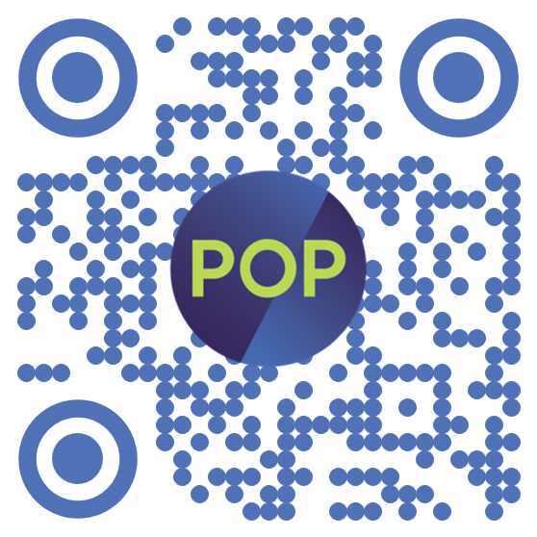


Thank You for Joining

